Slide 1
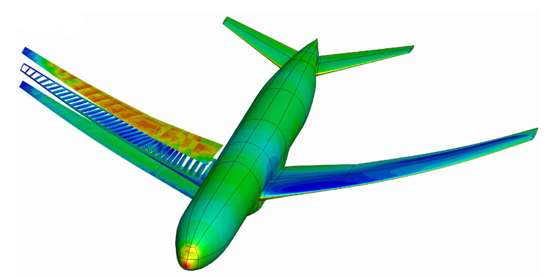
Mechanics and Materials part 1 1 – Vectors and Scalars
LO: State the difference between scalars and vectors. Explain how we add and resolve vectors.

Slide 2
Starter: Definitions
LO: State the difference between scalars and vectors. Explain how we add and resolve vectors.
What is a ‘scalar’ quantity?
What is a ‘vector’ quantity?
A scalar is a physical quantity which only has a magnitude (size), NOT a direction.
A vector is a physical quantity which has BOTH a magnitude and a direction.
Can you think of any examples of scalars and vectors?

Slide 3
Grouping scalars and vectors
LO: State the difference between scalars and vectors. Explain how we add and resolve vectors.
Group these quantities into scalar and vector groups:
Energy Distance Force
Displacement Speed Velocity
Acceleration Pressure Mass
Weight Density Momentum
Volume Temperature Electric current
Scalars:
Energy
Distance
Speed
Pressure
Mass
Density
Volume
Temperature
Vectors:
Force
Displacement
Velocity
Acceleration
Weight
Momentum
Electric current

Slide 4
Adding parallel vectors
LO: State the difference between scalars and vectors. Explain how we add and resolve vectors.
What do you get if you add 4 kg to 4kg?
This always gives you 8 kg, because mass is a scalar
How about if you add 4 N to 4 N?
Sometimes this will give you 8 N, but sometimes it will give you 0 N.
Why do you think this is?
Draw a scale diagram, with 1cm = 1 ms⁻¹, of:
1. An airport conveyer belt is travelling from left to right at a velocity of 1.50 ms⁻¹. What is the resultant velocity of a man running at 3.40 ms⁻¹ the opposite way along the airport conveyor belt?
1.50 – 3.40 = - 1.90 ms-1
2. What is the resultant velocity of a man walking at 2.00 ms⁻¹ in the same direction of travel as an airport conveyor belt travelling at 1.50 ms⁻¹
1.50 + 2.00 = 3.50 ms⁻¹

Slide 5
Representing vectors
LO: State the difference between scalars and vectors. Explain how we add and resolve vectors.
All vectors can be represented by arrows
The length of the arrow shows the magnitude of the vector quantity
The direction of the arrow gives the direction of the vector. A positive direction is from left to right and negative is from right to left.
Displacement: can be represented as an arrow from the first point to the second point on a map. Length must be proportional to distance.
Velocity: represented as an arrow of length in proportion to the speed and pointing in the direction of motion.
Force and Acceleration: represented by an arrow in correct direction and the length in proportion to their magnitude.
A cyclist travelled 50 km from point A to point B in an westerly direction

Slide 6
But, vectors aren’t always parallel
LO: State the difference between scalars and vectors. Explain how we add and resolve vectors.
TAP: 201-1 Adding Velocities demo
… sometimes they are at right angles. How could we work out the resultant velocity?
I need one person move the bridge at a constant speed,
Another to move the individual trolley at a constant speed,
And another to time the motion.
Then we will work out the velocities.

Slide 7
How can we work out the resultant velocity?
LO: State the difference between scalars and vectors. Explain how we add and resolve vectors.
We could draw a scale diagram and measure it.
Or, we could use some maths: Pythagoras or trigonometry.
Try both methods. Which is more accurate?

Slide 8
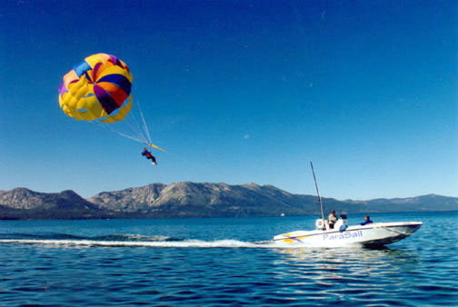
Resolving component vectors
LO: State the difference between scalars and vectors. Explain how we add and resolve vectors.
Example:
A paraglider is pulled along at a constant height at steady speed by a cable attached to a speed boat. The cable pulls on the paraglider with a force of 500 N at an angle of 35° to the horizontal. Calculate the horizontal and vertical components of this force.
How do we go about solving this?
Sketch what we know and add labels.
Decide how to solve the horizontal and vertical components. We know the length of one side of a triangle and an angle…
So we need to use trigonometry (SOHCAHTOA)
Horizontal: 500Cos35 = 410 N to the right
Vertical: 500Sin35 = 287 N vertically down.

Slide 9
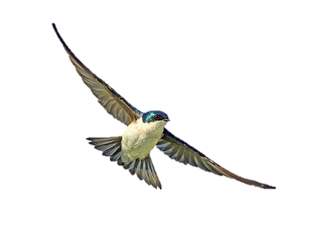
Practice questions
LO: State the difference between scalars and vectors. Explain how we add and resolve vectors.
Relative velocities and displacement
In these questions, you have to find the velocity and the displacement of a bird relative to the ground, when it is actually flying relative to the wind.
Flying in a side wind
A bird flies at a steady speed of 3 m s^{–1} through the air. It is pointing in the direction due north. However, there is a wind blowing from west to east at a speed of 2 m s^{–1}.
What is the velocity of the bird relative to the ground?
What is the displacement of the bird, relative to its starting point, after it has flown for 20 seconds?
In what direction should the bird point if it is to travel in a northerly direction?

Slide 10
Answers
LO: State the difference between scalars and vectors. Explain how we add and resolve vectors.
1. The magnitude of the resultant velocity is found using Pythagoras' theorem as the two vectors to be added are at right angles.
Hence: magnitude of velocity relative to the ground
= 3.6 ms⁻¹
The direction is found by drawing a vector diagram or using trigonometry. It is 33.7° due East of North.
2. After 20 s, the displacement of the bird is found from displacement = velocity x time. The direction of displacement is as for velocity if the velocity is constant. The magnitude of the displacement is simply 3.6 m s^{–1} x 20 s = 72 m.
3. To fly due north, the bird has to fly in such a direction that it has a component of its velocity that cancels out the velocity of the wind. This means that it has to have a component of velocity equal to 2 m s^{–1} west.

Slide 11
Plenary: Questions
LO: Explain and demonstrate how there can be an equilibrium of forces.
Collins textbook pages 191-194
Read through the text, it should summarise what we have been looking at this lesson.
Write a short summary of the different between scalars and vectors and explain how we add and resolve vectors.
Complete the questions within the text (Q9-17)
Your homework is to complete these.
Your homework throughout the topic is to complete the ‘mechanics and materials 1’ board on Isaac Physics.

Slide 12
Mechanics and Materials part 1 2 – Balanced forces
LO: Explain and demonstrate how there can be an equilibrium of forces.

Slide 13

Starter: Forces in equilibrium
LO: State the difference between scalars and vectors. Explain how we add and resolve vectors.
When are forces in equilibrium?
… In other words, when are forces on an object balanced?
When it is at rest…
Or, when it is moving at a constant speed.

Slide 14
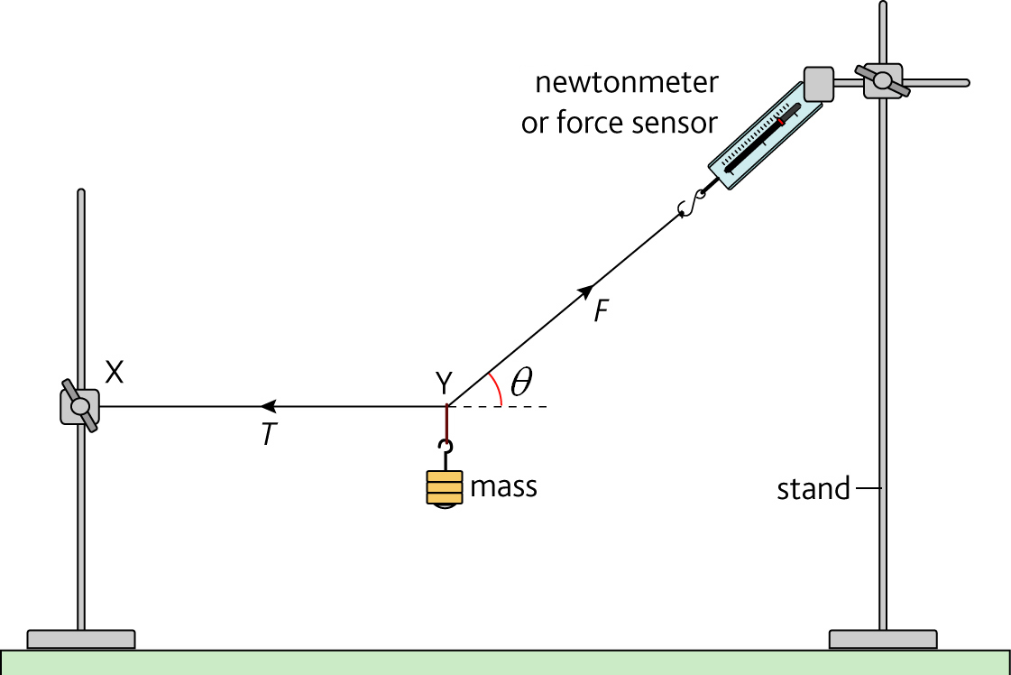
Practical Investigation: Coplanar forces
LO: State the difference between scalars and vectors. Explain how we add and resolve vectors.
Read the instructions carefully.
Safety: How are you going to secure the retort stands to make sure they don’t topple over?
Draw a suitable table for your results. Plot a graph as detailed on the instruction sheet.

Slide 15
Investigation discussion
LO: State the difference between scalars and vectors. Explain how we add and resolve vectors.
How did you make sure that ‘XY’ was horizontal?
You should have taken vertical measurement from the bench at points X and Y. Then, used a set square to ensure that the ruler is vertical.
What is the equation for the line of your graph?
Drawing a closed triangle of the forces, or resolving the forces into their components, shows that mg = F sin θ. This is the equation of the graph (in the form y = mx + c), where sin θ is the gradient.

Slide 16
Example equilibrium: girl on a swing
LO: State the difference between scalars and vectors. Explain how we add and resolve vectors.
For the resultant force to be zero, each pair of forces must be balanced
There are three forces in total, and each must be balanced in the opposite direction
You then need to use Pythagoras and Trigonometry to resolve T…
TcosƟ
Tension, T
Force, F₁
TsinƟ
Weight, W
Resultant of F₁ and W
Now try it yourselves using pg 30-31 of ‘Maths Skills for A-level Physics’

Slide 17
Plenary questions:
LO: State the difference between scalars and vectors. Explain how we add and resolve vectors.
These should be completed on your mwbs:
Show with a vector triangle that an object is in equilibrium if only these forces are acting on it: 12 N acting east, 5.0 N acting north, 13 N at 23° anticlockwise from west.
These three forces are in equilibrium: 7.1 N acting west, 14.6 N acting South and an unknown force F acting 64° anticlockwise from East. Draw a free body force diagram to show these forces and find the magnitude of force F.
If a body is in equilibrium, what is the sum of all the forces acting on it?
Explain what equilibrium means in the context of moving objects.

Slide 18
Mechanics and Materials part 1 3 – The Principal of Moments
LO: Explain what the principal of moments is and demonstrate this experimentally

Slide 19
Starter: Balancing a ruler
LO: Explain what the principal of moments is and demonstrate this experimentally
What can I do to make this ruler balance without changing the number of masses?
I can change the distance…
By changing the distance, you have changed the turning force. The turning force is the moment.
Moment (Nm) = Force (N) x distance (m)
The principal of moments states that for an object to be balanced, the clockwise moment must be equal to the anticlockwise moment.
Sum of clockwise moments = Sum of anticlockwise moments

Slide 20
Calculating the mass of a ruler
LO: Explain what the principal of moments is and demonstrate this experimentally
We have to know where the centre of mass is, then…
d = 10 cm
d = 15 cm
Centre of mass!
Weight of beam
W = 100g

Slide 21
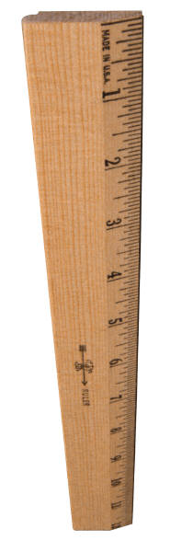
Investigation: Density of a metre ruler
LO: Explain what the principal of moments is and demonstrate this experimentally
You have ~ 20 minutes for the practical part of this investigation
10 min to measure volume
10 min to measure mass
Then complete the questions
Useful equations:
Volume = length x width x depth
Density = mass / volume
Moment = force x perpendicular distance

Slide 22
Plenary: TAP Moments questions
LO: Explain what the principal of moments is and demonstrate this experimentally
1 Taking moments about the feet.
600 x 2 = W x 1.5 so W = 800 N
2 Taking moments around the left hand edge of the beam near the wall
(a) T sin 30° x 0.5 = 200 x 0.5 so T sin 30° = 200 and T = 400N
(b) T sin 30° x 0.5 = 200 x 0.25 so T x 0.5 = 50 and T = 200N
(c) T sin 30° x 0.5 = (200 x 0.5) + (200 x 0.25) = 150 so T = 600N
(d) T sin 50° x 0.25 = (200 x 0.5) + (200 x 0.25) =150 so T = 783N
3 Taking moments about the LHS and working in kN.
(7 x 4 kN) + (10.5 x 10 kN) + (15.75 x 8 kN) = vertical force x 21
28 + 105 + 126 = 259. So vertical force = 259/21 = 12.3 kN
A similar calculation can be performed by taking moments around the RHS of the bridge.
Alternatively In equilibrium upward force = Downward force
So 22 kN = 12.3 kN + force on RHS of bridge. Force = 9.7 kN
(b) The weight of the bridge has been ignored so upward forces will be larger.

Slide 23
More answers…
LO: Explain what the principal of moments is and demonstrate this experimentally
4 Taking moments about corner A
(a) T x 3 = W x 1 so 2.0 x 106 x 3.0 = W so W = 6 x 106 N
Taking moments about corner B.
(b) T x 3 = (W x 1.5) + (1.6 X 105 x 0.5) so 6 x 106 = 1.5 W + 8 x 104 and W = 3.95 x 106 N
(c) Not if it were the same type of concrete

Slide 24
Mechanics and Materials part 1 4 – More on Moments
LO: Define a ‘couple’ and use the principal of moments in situations with more than one point of support.

Slide 25
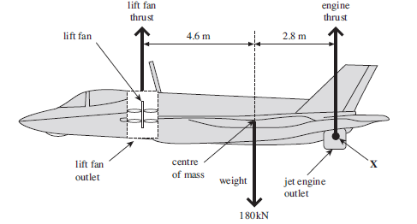
Starter: What’s going on here?
LO:Define a ‘couple’ and use the principal of moments in situations with more than one point of support.
This acts as a ‘pivot’, so we can take clockwise and anticlockwise moments about this point.
This also acts as a ‘pivot’, so we can take clockwise and anticlockwise moments about this point too.

Slide 26
Moment = Force x distance, so with two supports…
LO:Define a ‘couple’ and use the principal of moments in situations with more than one point of support.
Sy (support force of pillar Y)
dx (distance between W and pillar x)
dy (distance between W and pillar Y)
Sx (support force of pillar x)
The moment around pillar X:
Anticlockwise moment = Sy x D
Clockwise moment = W x dx
Therefore SyD = Wdx
What about the moment around pillar Y?
SxD = Wdy
Weight, W (Centre of mass)
Pillar x
Pillar Y
D (distance between two pillars)

Slide 27
More on moments questions
LO:Define a ‘couple’ and use the principal of moments in situations with more than one point of support.
Complete the questions on the worksheet, you will also need to know this definition and equation:
When you have finished check your answers, then complete the summary questions in the textbook.
A couple is a pair of equal and opposite coplanar forces. E.g. your hands on a stearing wheel, they act along a straight line, but one acts up and the other down. The moment of a couple is:
Couple = magnitude of one force x perpendicular distance between the two forces forming the couple
(Nm) (N) (m)

Slide 28
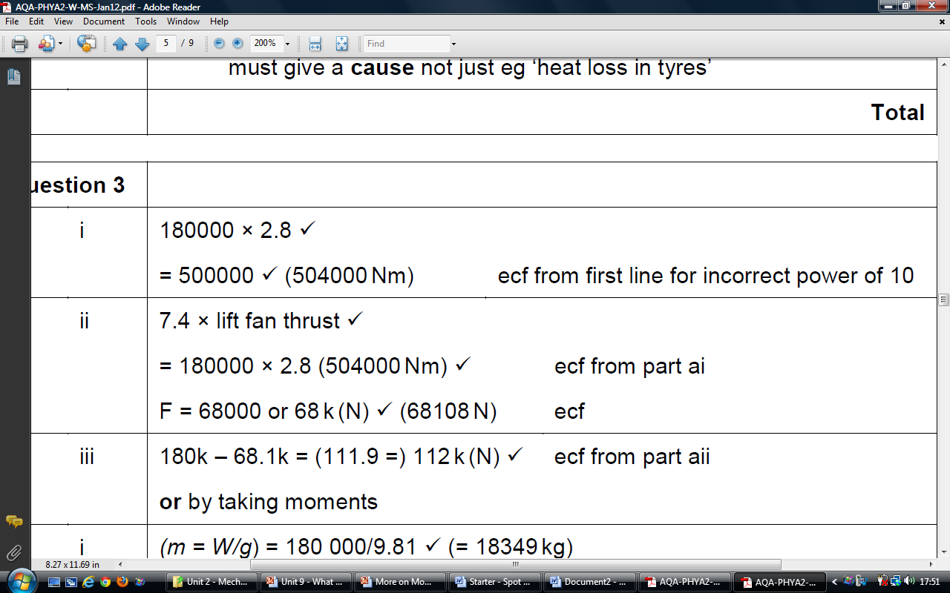
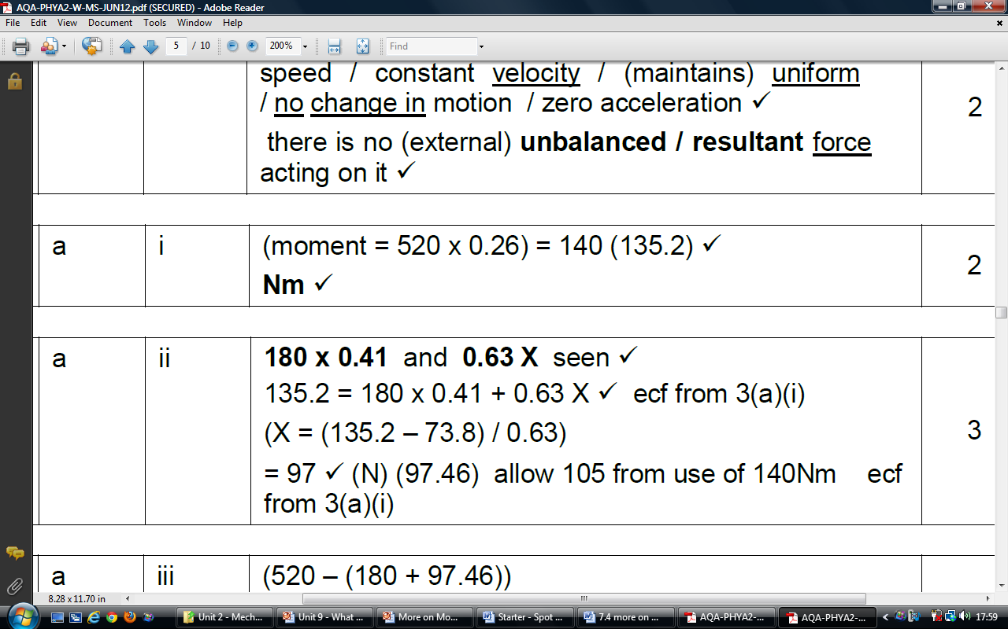
Answers
LO:Define a ‘couple’ and use the principal of moments in situations with more than one point of support.
1. 12 x 0.5 = 6 Nm

Slide 29
Plenary: Copy and complete:
LO:Define a ‘couple’ and use the principal of moments in situations with more than one point of support.
The moment of a force about a point is equal to force multiplied by the ……………… distance from the ……………… to that point
Moments are measure in ………………………
The principle of moments states that, if an object is in …………………………, the total …………………… moments are ……………………… to the total ……………………… moments
A couple consists of two forces of equal ……………………… acting in …………………… directions. A couple has no resultant force. It only produces a ………………………… effect.
A weight of x N acts in an anticlockwise direction 20 cm from a pivot. This is balanced by a clockwise force of 4 N which is 45 cm from the pivot. What is force x ?

Slide 30
Mechanics and Materials part 1 5 - Stability
LO: Explain the difference between stable and unstable objects.

Slide 31
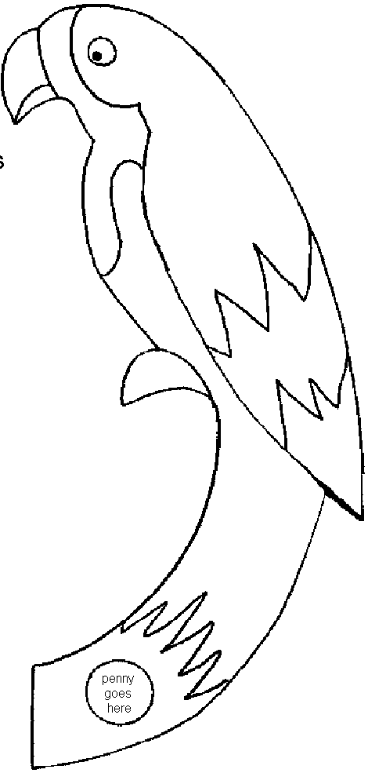
How is stability related to centre of mass?
LO: Explain the difference between stable and unstable objects.
Find the centre of mass of your parrot:
Cut out your shape
Hang it from a clamp stand, with a plumb line
Draw along the plumb line onto your shape
Now rotate the shape and hang it again
Draw the new plumb line
Where the two lines overlap, this is your centre of mass!
Where is the centre of mass of a regular shape?

Slide 32
Stable vs unstable equilibrium
LO: Explain the difference between stable and unstable objects.
If an object’s centre of mass is hanging below its point of support, we say it is stable equilibrium.
If the centre of mass is above its point of support, we say it is in unstable equilibrium.
Why is this?
When the CoM is below the point of support, and the object is displaced, the object’s weight serves to return it to equilibrium.
When it is above the point of support, if the object gets displaced, the line of action of the weight will move it further from equilibrium. This is because there is a resultant moment!
Now, read pg 121-122 of the CGP book and complete the questions

Slide 33
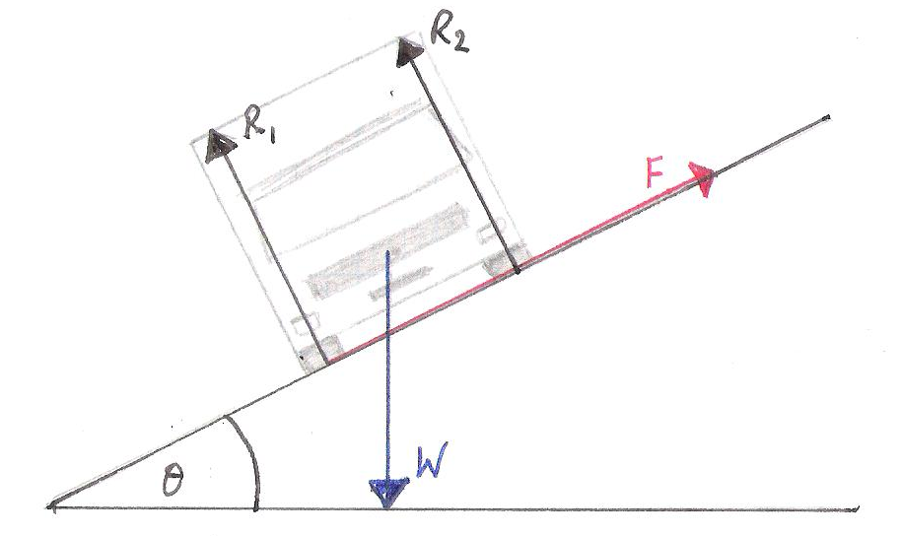
Stability
LO: Explain the difference between stable and unstable objects.
How can you make an object more stable?
What happens if you stand a tall object on a slope? Why?
It topples over because the line of action of its weight acts outside of its base area.
If it doesn’t topple over, we can calculate the force of friction keeping it in place. Look at the diagram above, what do you think we need to do?
Now complete all of the on a slope questions

Slide 34
Plenary
LO: Explain the difference between stable and unstable objects.
Explain the following:
A Bunsen burner has a wide heavy base
Racing cars are low with wheels wide apart
A boxer stands with his legs wide apart
A wine glass containing wine is less stable
Lorries are less stable if carrying a load

Slide 35
Homework
LO: Explain the difference between stable and unstable objects.
Pg 246 – 249 of Collins book – questions
Due:

Slide 36
Mechanics and Materials part 1 6 – Equilibrium rules
LO: Explain the conditions an object in equilibrium is under

Slide 37
Starter: Conditions for equilibrium
LO: Explain the conditions an object in equilibrium is under
Thinking about what we have covered so far, what are the conditions for an object in equilibrium?
Resultant force must be zero. If there are three forces, they form a triangle.
The principle of moments must apply (moments about a point must balance!)

Slide 38
Free body force diagrams and other rules
LO: Explain the conditions an object in equilibrium is under
Drawing a free body force diagram means just including the forces, with arrows proportional to their length. If the object is in equilibrium, these can be joined to form a triangle.
Calculate the moments about one or more points in order to calculate the unknown force
Resolve the forces to find the total force acting in a convenient direction (vertically, or horizontally). This must be zero.
R
W
F
Have a go at the practice questions using these rules.

Slide 39
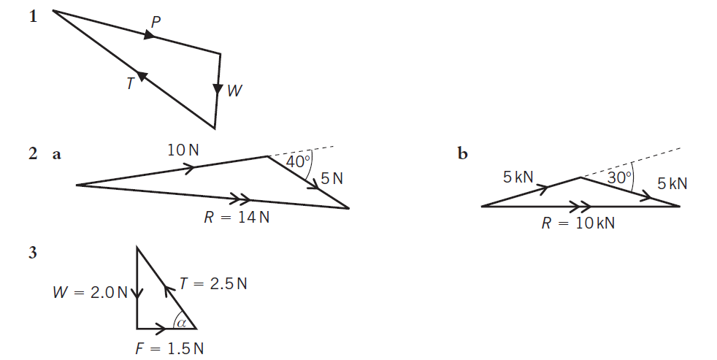
Answers
LO: Explain the conditions an object in equilibrium is under

Slide 40
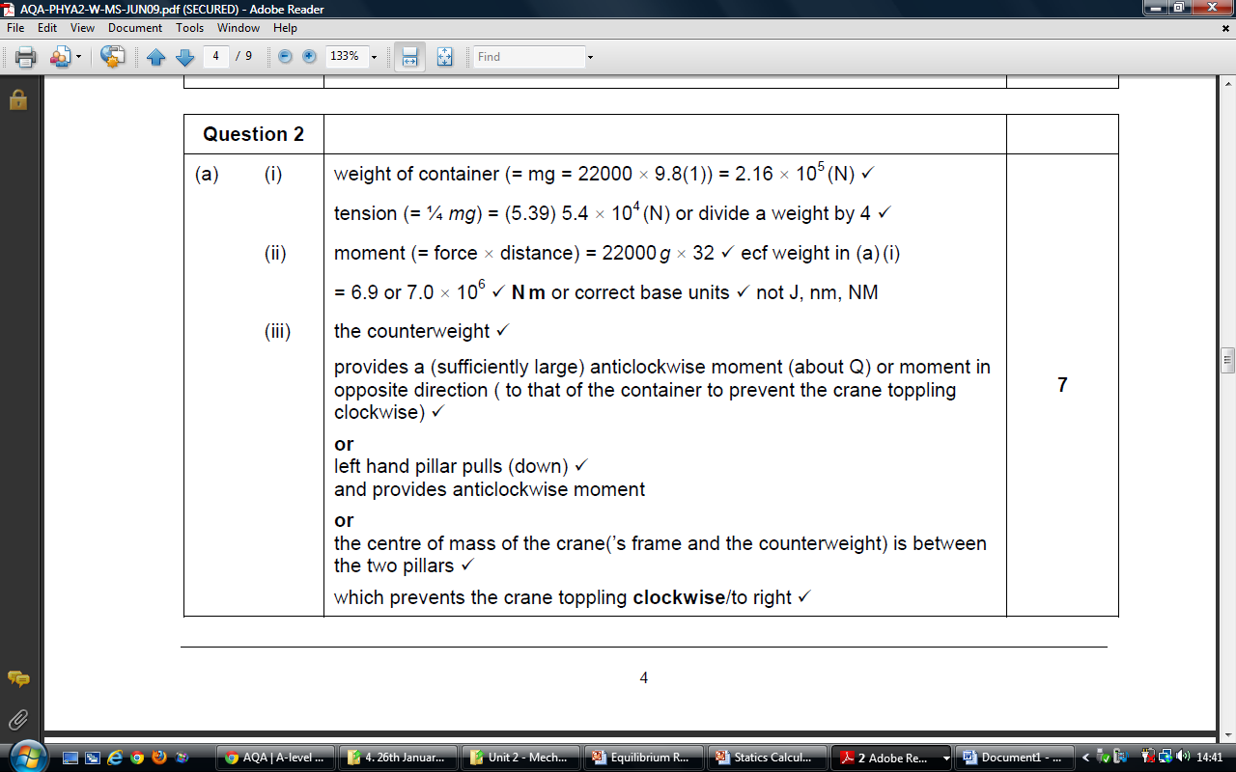
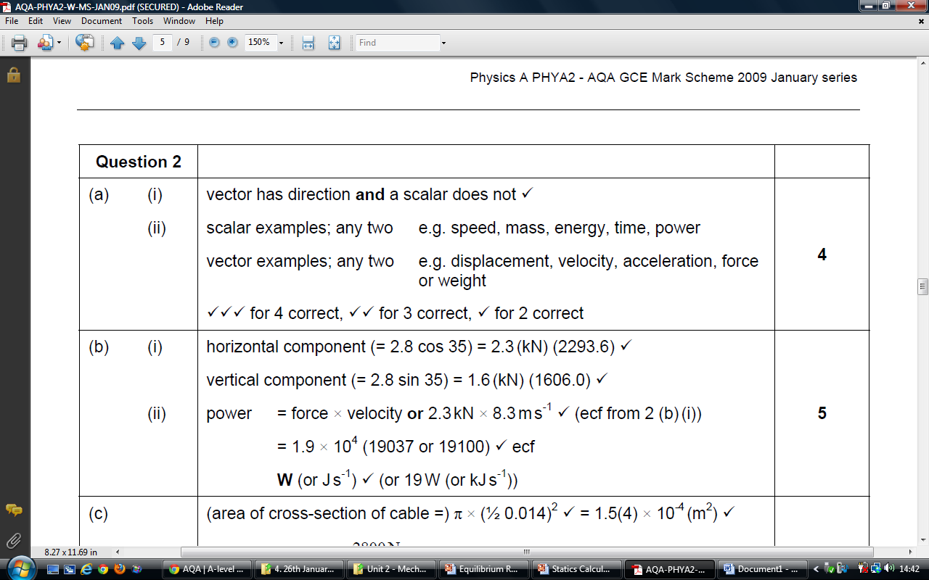
Answers
LO: Explain the conditions an object in equilibrium is under

Slide 41
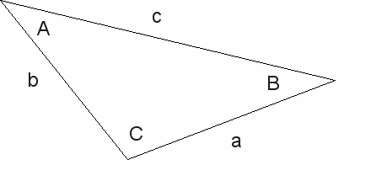

The Sine Rule
LO: Explain the conditions an object in equilibrium is under
$\frac{a}{sinA}$ = $\frac{b}{sinB}$ = $\frac{c}{sinC}$
This is not a requirement for your spec., but it does overlap with maths

Slide 42
Plenary
LO: Explain the conditions an object in equilibrium is under
A cyclist climbs a 1 in 5 slope. The combined weights of the cyclist and the bike are 950 N. The frictional forces acting on the cyclist are 40 N.
By resolving the weight, calculate the force acting down the slope.
Calculate the force he must exert on the road to climb at a constant speed.

Slide 43
Mechanics and Materials part 1 8 – Speed and Velocity
LO: Explain how we know if an object is changing speed from data and from graphs

Slide 44
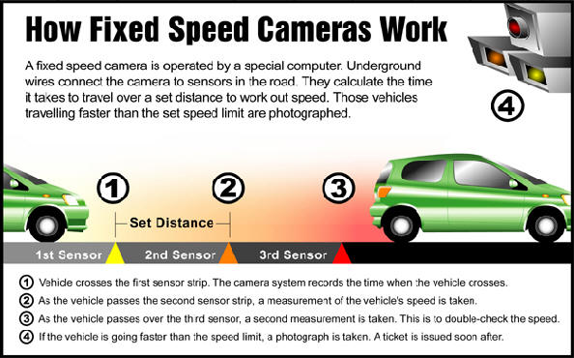
Starter: How do speed cameras work?
LO: Explain how we know if an object is changing speed from data and from graphs
Discuss and write down or draw a diagram of how you think they work.
They have to measure how far you travel in a certain amount of time – that’s what the lines on the floor are for!

Slide 45
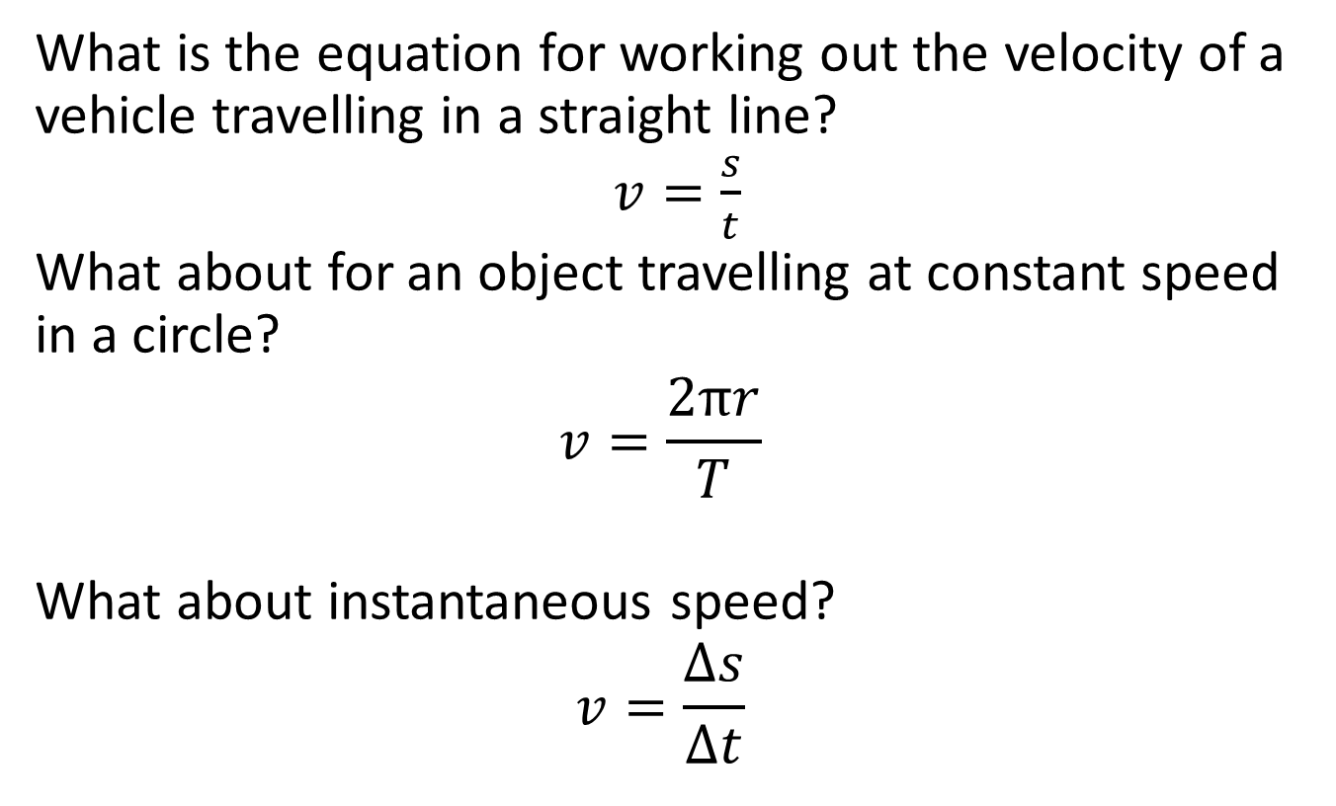
Calculating speed
LO: Explain how we know if an object is changing speed from data and from graphs
What is the equation for working out the velocity of a vehicle travelling in a straight line?
$v=\frac{s}{t}$
What about for an object travelling at constant speed in a circle?
$$v=\frac{2πr}{T}$$
What about instantaneous speed?
$$v=\frac{∆s}{∆t}$$

Slide 46
Distance-time graphs
LO: Explain how we know if an object is changing speed from data and from graphs
Looking at the data in this table:
Is the car travelling at a constant speed or a changing speed?
Plot a distance-time graph of the data
What is the shape of the line?
Work out the gradient
Notice what measurement the gradient gives you…
Time (s) | Distance (m)
0 | 0
2 | 6
4 | 12
6 | 18
8 | 24
10 | 30
12 | 36

Slide 47
What if I had changing speed?
LO: Explain how we know if an object is changing speed from data and from graphs
This may produce a curve on a graph…
How would I work out the instantaneous speed at any point?
I would need to draw a tangent to the curve.
Then I would work out the gradient of the tangent.
This would give me the instantaneous speed of that bit of the curve.

Slide 48
Displacement-time graphs
LO: Explain how we know if an object is changing speed from data and from graphs
How might these be different to distance time graphs?
Displacement is a vector, therefore has a direction
That means it can be positive or negative – your overall displacement can also be zero if you returned to the point where you started.
Sketch a displacement time graph for a ball being thrown into the air (reaching a total height of 6 m), then falling back to the place it started from, taking a total time of 8 seconds.

Slide 49
Plenary questions
LO: Explain how we know if an object is changing speed from data and from graphs
You are watching a batsman hit a cricket ball. If 0.375 s passes between the time you see him strike the ball and the time you hear the sound of this, how far from the batsman are you sitting? The speed of sound in air is 340 m s^{–1}. (The speed of light is nearly a million times bigger than this, so you see the bat hit the ball more or less at the instant it occurs.)
A girl diving from a 15 m platform wishes to know how fast she enters the water. She is in the air for 1.75 s and dives from rest (with an initial speed of zero). What can you tell her about her entry speed?
An experiment performed on the Moon finds that a feather falls 20.75 m from rest in 5 s. What is its speed as it hits the Moon's surface?
You are travelling in a car moving at 50 km h^{–1} (just over the 30 mph speed limit). What is this speed in m s^{–1}? You have to brake so the car comes to rest uniformly in 1.4 s, how far will you travel? A cat runs out in front of your car and your reaction time is 0.6 s. What is the total distance the car will travel before stopping?

Slide 50
Plenary Answers
LO: Explain how we know if an object is changing speed from data and from graphs
= 128 m to 3sf
As she dives from rest, her final speed must be twice this average (if we assume that she accelerates uniformly). So, her speed on entry is =17 ms⁻¹ to 2sf
The solution to this problem is similar to that for question 2. Find the average speed and then double it. The average speed is 4.15 ms⁻¹. Hence: final speed is double the average = 8.30 ms⁻¹.
To convert 50 km h^{–1} to m s^{–1}: 50 km h^{–1} = 50 km h^{–1} x 1000 m km^{–1} / 3600 s h^{–1} = 13.8 m s^{–1}.
The average speed of the car is half the maximum, or 6.9 m s^{–1}. Then: distance = speed x time = 6.9 m s⁻¹ x 1.4 s = 9.7 m
When the cat runs out, you first move for 0.6 s at the maximum speed of 13.8 m s^{–1}. Hence, the additional 'thinking distance' travelled is distance = speed x time = 13.8 m s^{–1} x 0.6 s = 8.3 m
Thus, the total distance travelled is 8.3 m + 9.7 m = 18 m.

Slide 51
Mechanics and Materials part 1 9 - Acceleration
LO: Explain the difference between uniform and non-uniform acceleration.

Slide 52
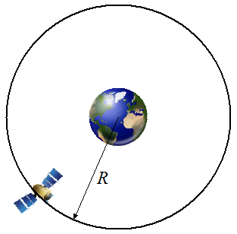
Starter: Acceleration definition
LO: Explain the difference between uniform and non-uniform acceleration.
Can you write one?
Acceleration is defined as a change of velocity per unit time.
That means it is a vector quantity – it depends on both speed and direction. That’s why something travelling in a circle at constant speed is said to be accelerating!

Slide 53
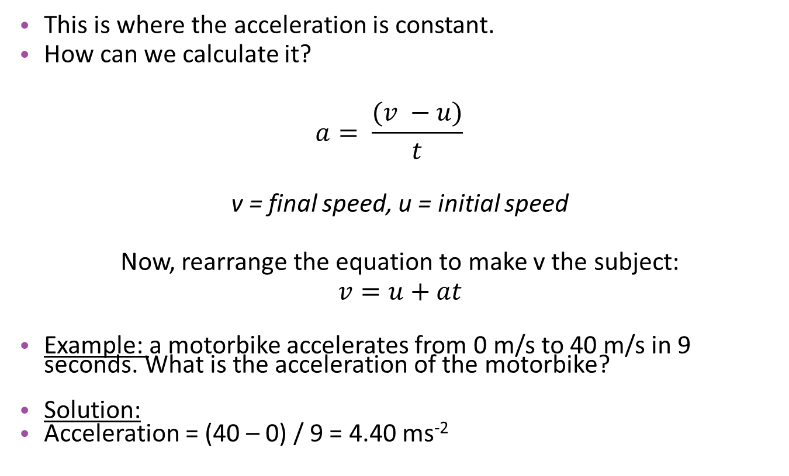
Uniform acceleration
LO: Explain the difference between uniform and non-uniform acceleration.
This is where the acceleration is constant.
How can we calculate it?
$$a= \frac{(v −u)}{t}$$
v = final speed, u = initial speed
Now, rearrange the equation to make v the subject:
$v=u+at$
Example: a motorbike accelerates from 0 m/s to 40 m/s in 9 seconds. What is the acceleration of the motorbike?
Solution:
Acceleration = (40 – 0) / 9 = 4.40 ms⁻²

Slide 54
Uniform vs non-uniform acceleration
LO: Explain the difference between uniform and non-uniform acceleration.
Uniform acceleration:
This is when the acceleration is constant. We can calculate this using: v – u / t
Non-uniform acceleration:
This is when the direction or speed of an object changes at a varying rate
We can draw velocity time graphs to show how the speed of an object changes with changing acceleration.
Plot the velocity-time graph from the data shown
Describe what is happening to the acceleration of the car
Work out the gradient between 4 and 5 s, what measurement does the gradient give you?
What would the area under the graph give you?
Time (s) | Velocity (m/s)
0 | 0.0
1 | 0.5
2 | 1.0
3 | 2.5
4 | 4.0
5 | 7.0
6 | 7.0
7 | 5.0
8 | 3.0
9 | 0.0

Slide 55
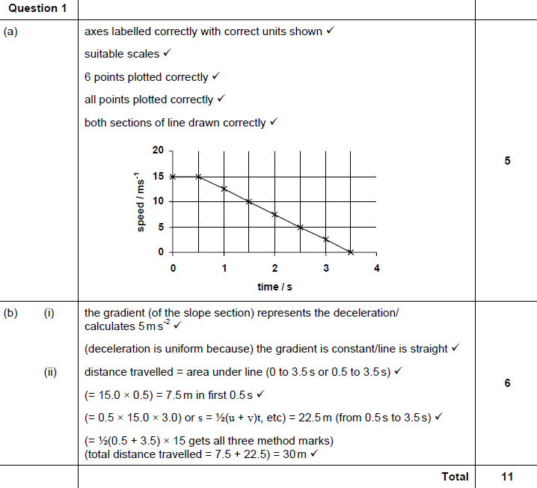
Plenary: Exam q – Jan ‘09 Q1
LO: Explain the difference between uniform and non-uniform acceleration.

Slide 56
Mechanics and Materials part 1 10 – Uniform acceleration
LO: Calculate the displacement of an object moving with uniform acceleration.

Slide 57
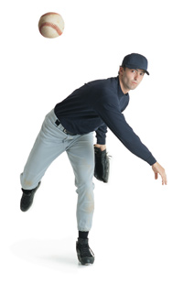
Starter: SUVAT
LO: Calculate the displacement of an object moving with uniform acceleration.
.
Write the following letters into your notes. Next to them, write what the symbol stands for and what it is measured in:
s
u
v
a
t
= distance (or displacement) measured in metres
= initial velocity measured in metres per second
= final velocity measured in metres per second
= acceleration measured in metres per second squared
= time measured in seconds

Slide 58
Distance-time graph practice
LO: Calculate the displacement of an object moving with uniform acceleration.
.
6
Copy these axes onto your mwbs. You need to sketch the graph that a volunteer is going to walk for us….
5
4
Distance / m
3
2
1
0
0
5
10
15
20
25
30
Time / s

Slide 59
It should look like this:
LO: Calculate the displacement of an object moving with uniform acceleration.
.
Does this show changing or constant velocity?
How could we work out acceleration?

Slide 60
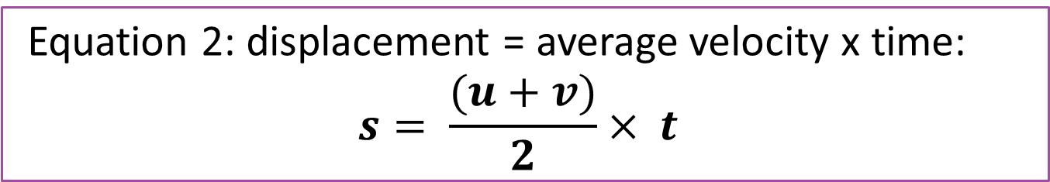
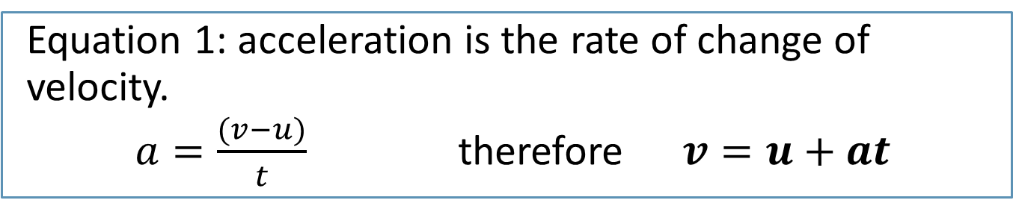
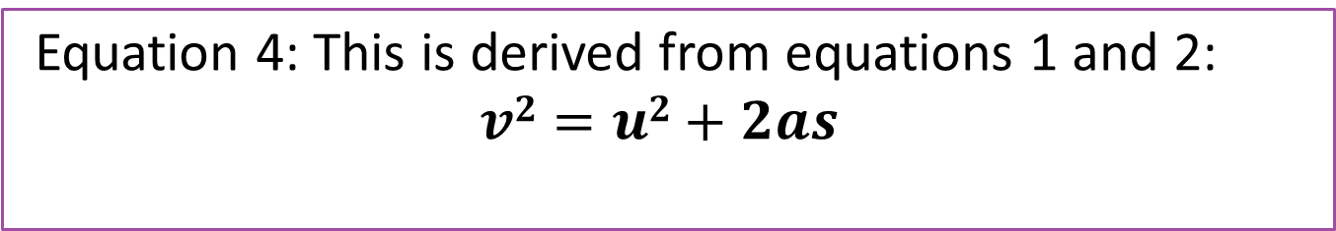
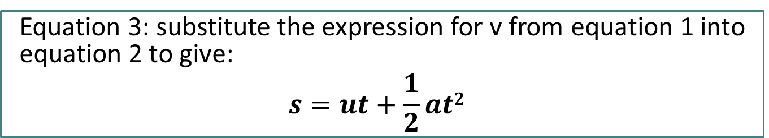
Equations of motion
LO: Calculate the displacement of an object moving with uniform acceleration.
.
Equation 1: acceleration is the rate of change of velocity.
$a=\frac{(v−u)}{t}$ therefore $v=u+at$
Equation 2: displacement = average velocity x time:
$$s= \frac{(u+v)}{2}× t$$
Equation 3: substitute the expression for v from equation 1 into equation 2 to give:
$$s=ut+\frac{1}{2}at2$$
Equation 4: This is derived from equations 1 and 2:
$$v2=u2+2as$$

Slide 61
Knowing which equation to use
LO: Calculate the displacement of an object moving with uniform acceleration.
.
Example:
A tile falls from a roof 25 m high. Calculate its speed when it hits the ground and how long it takes to fall. Take g = 9.81 ms⁻².
Write down what you know:
s = 25 m
u = 0 ms⁻¹
v = ?
a = 9.81 ms⁻²
t = ?
Then, choose an equation with only one unknown quantity. So start with equation 4.
Now, find t using equation 3.
V = 22 ms⁻¹ and t = 2.3 s

Slide 62
Your turn
LO: Calculate the displacement of an object moving with uniform acceleration.
.
Question
A car accelerates steadily from rest at a rate of 4.2 ms⁻² for 6.0 s. Calculate its final speed and the distance travelled.
Write down what you know.
Calculate the speed using equation 1.
Calculate the distance using equation 2 or 3.
V = 25 ms⁻² and s = 75.6 m

Slide 63
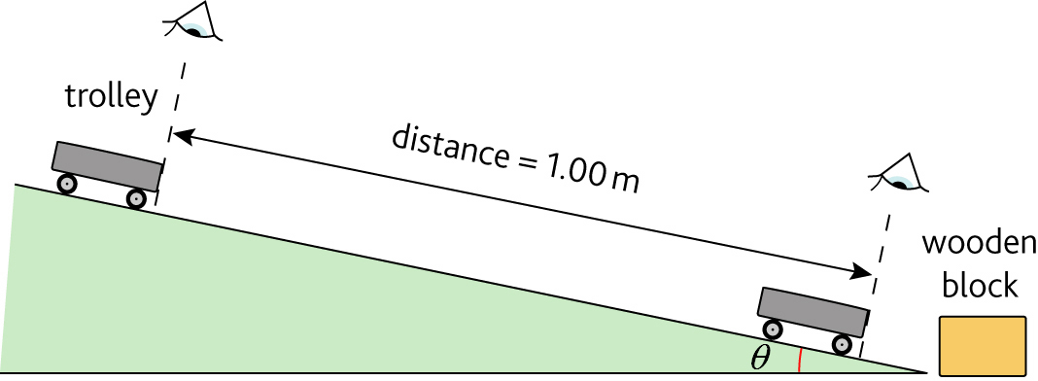
Practical investigation: Acceleration
LO: Calculate the displacement of an object moving with uniform acceleration.
.
Follow the instructions and safety guidance carefully.

Slide 64
LO: Calculate the displacement of an object moving with uniform acceleration.
.

Slide 65
Plenary questions (mwbs)
LO: Calculate the displacement of an object moving with uniform acceleration.
.
A cat runs with uniform acceleration from rest to 10 ms⁻¹ in 20.0 s. What is its displacement after this time?
100 m
The brakes are applied to a train travelling at 25 ms⁻¹ and it takes 18 s to stop with uniform deceleration. What is its deceleration?
1.4 ms⁻²
An electric tram sets off from rest and travels 103 m in 9.2 s. Calculate its acceleration during this time, assuming it was uniform.
2.4 ms⁻²

Slide 66
Mechanics and Materials part 1 11 and 12 – Free Fall
LO: Define free fall and carry out a free fall experiment to determine the value g.

Slide 67
Starter: What is free fall?
LO: Define free fall and carry out a free fall experiment to determine the value g.
What do we mean when we say an object is in ‘free fall’?
Free fall is when there is gravity acting on an object and nothing else. It is the motion of an object undergoing an acceleration of ‘g’.
What is the magnitude of g?
9.81 ms-2
Do objects of different weights fall at different speeds?
https://www.youtube.com/watch?v=E43-CfukEgs

Slide 68
Required practical 3: Determination of g by a free fall method
LO: Define free fall and carry out a free fall experiment to determine the value g.
You each researched a method (with references!) for your homework. What methods did we come up with?
You are going to carry out three different methods:
Light gates
G-balls
Stopwatches and rulers
Read the instructions. These are intentionally vague because I want you to write your own methods, draw your own results tables and decide which is the most accurate method and why.

Slide 69
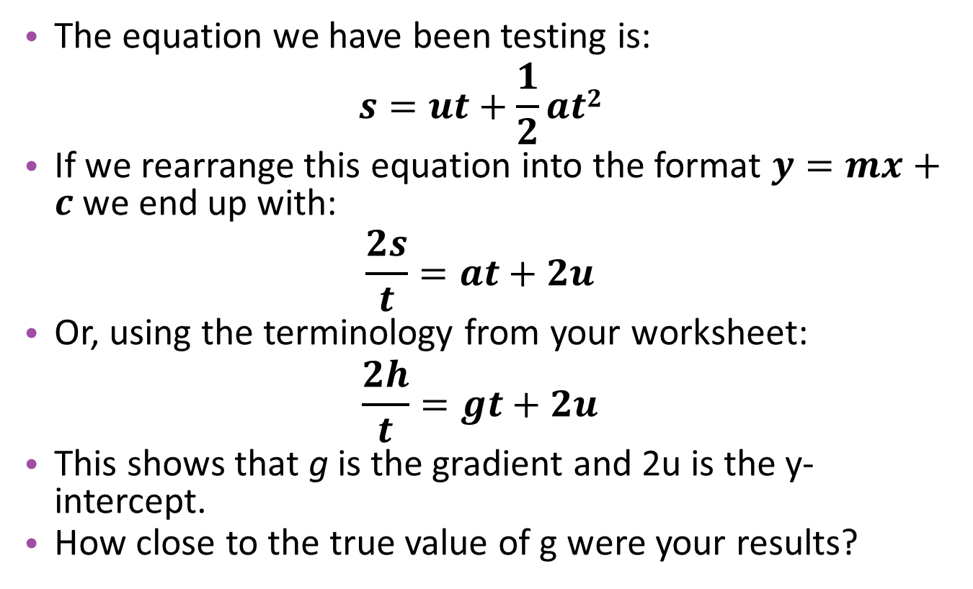
Plenary: What do your results show?
LO: Define free fall and carry out a free fall experiment to determine the value g.
The equation we have been testing is:
$$s=ut+\frac{1}{2}at2$$
If we rearrange this equation into the format $y=mx+c$ we end up with:
$$\frac{2s}{t}=at+2u$$
Or, using the terminology from your worksheet:
$$\frac{2h}{t}=gt+2u$$
This shows that g is the gradient and 2u is the y-intercept.
How close to the true value of g were your results?

Slide 70
Mechanics and Materials part 1 13 – Motion graphs
LO: Distinguish between different motion graphs and master two-stage problems.

Slide 71
Starter: Differences
LO: Distinguish between different motion graphs and master two-stage problems.
Answer these on your mini-whiteboards:
What are the differences between distance-time and displacement-time graphs?
What are the differences between a velocity-time and a speed-time graph?

Slide 72
Distance vs displacement
LO: Distinguish between different motion graphs and master two-stage problems.
Time / s | Displacement / m
0 | 0
0.5 | 1
1 | 2
1.5 | 2.5
2 | 3
2.5 | 3.5
3 | 3.8
3.5 | 3.9
4 | 4
4.5 | 3.9
5 | 3.8
5.5 | 3.5
6 | 3
6.5 | 2.5
7 | 2
7.5 | 1
8 | 0
Plot this data as a displacement-time graph
Describe what it shows
Now draw a new table and convert the data into time and distance.
Plot the distance time graph on the same axes in a different colour.
Label on both graphs where the maximum height is

Slide 73
What should they look like?
LO: Distinguish between different motion graphs and master two-stage problems.
Time / s | Distance / m
0 | 0
0.5 | 1
1 | 2
1.5 | 2.5
2 | 3
2.5 | 3.5
3 | 3.8
3.5 | 3.9
4 | 4
4.5 | 4.1
5 | 4.2
5.5 | 4.5
6 | 5
6.5 | 5.5
7 | 6
7.5 | 7
8 | 8

Slide 74
Velocity-time graph
LO: Distinguish between different motion graphs and master two-stage problems.
What happens to the velocity at each point of your displacement-time graph?
What would a sketch of a velocity-time graph for this data look like? Sketch this on your mwb.
How would we work out its acceleration?
How would we work out the displacement during its ascent (going up)
How about in its descent?

Slide 75
Two-stage problems
LO: Distinguish between different motion graphs and master two-stage problems.
The best way of getting to grips with these is to practice them…
If you have a two stage problem, then the acceleration / velocity / distance / time may not be the same in each part.
The only similarity is that the final velocity of the first part will be the initial velocity of the second part.
The summary questions involve lots of 2 part questions. We will do the first part together – so have your mini-whiteboards ready!
Now you can complete the remaining summary questions. We will go through the answers together at the end. Then we can try some exam questions.

Slide 76
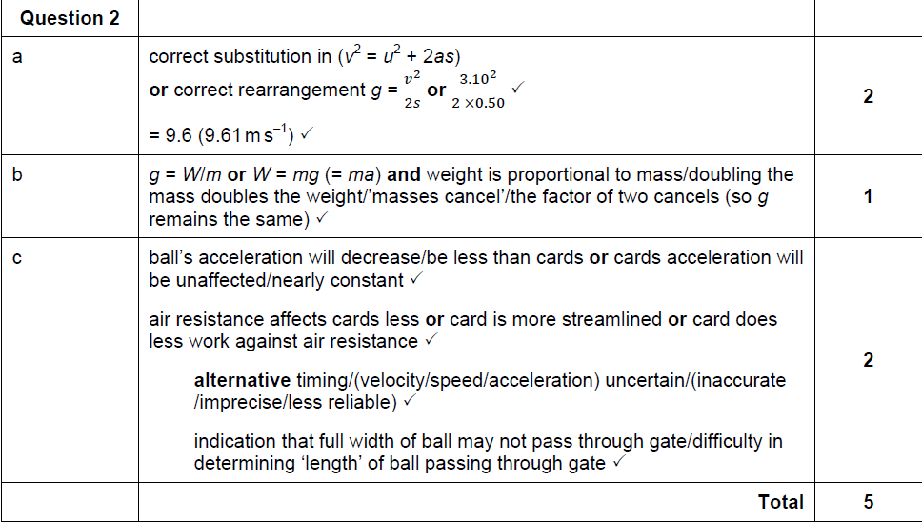
June ‘11 Q2
LO: Distinguish between different motion graphs and master two-stage problems.

Slide 77
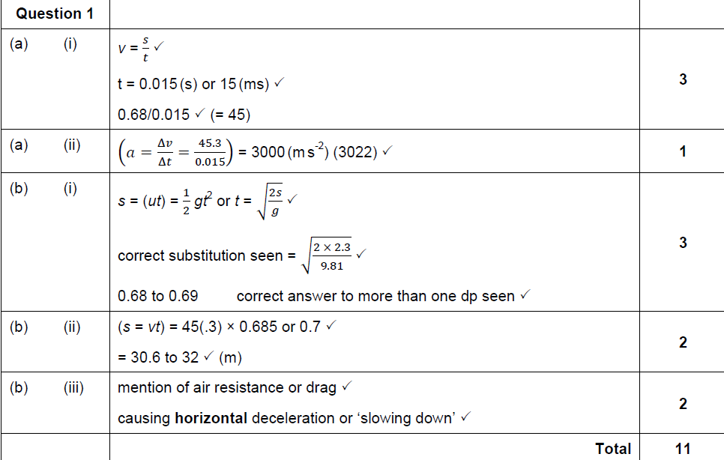
Jan ‘10 Q1
LO: Distinguish between different motion graphs and master two-stage problems.

Slide 78
Mechanics and Materials part 1 14 & 15 – Projectile Motion
LO: Describe the effect of gravity on horizontal and vertical speed

Slide 79
Starter: Parabolas
LO:Describe the effect of gravity on horizontal and vertical speed
If I throw a ball, it follows a parabolic path – it should follow this parabola:

Slide 80
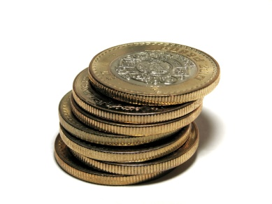
Coins dropping
LO:Describe the effect of gravity on horizontal and vertical speed
Watch these two coins
What is different about the path they take to the floor?
What about when they hit the floor?
What does this tell you about their vertical velocity?
What about their horizontal velocity?
Now draw a diagram to show the different paths they take to the floor, label it with the answers to the questions above.

Slide 81
Horizontal projection
LO:Describe the effect of gravity on horizontal and vertical speed
If we take photos of our coins, we should see that at each instant they are at the same distance from the ground. This means they have the same vertical component.
If the horizontal component of the velocity is constant, it should have the same displacement between each photo.
We can see horizontal projection has a vertical and a horizontal component…
(Pearls of water demo)

Slide 82
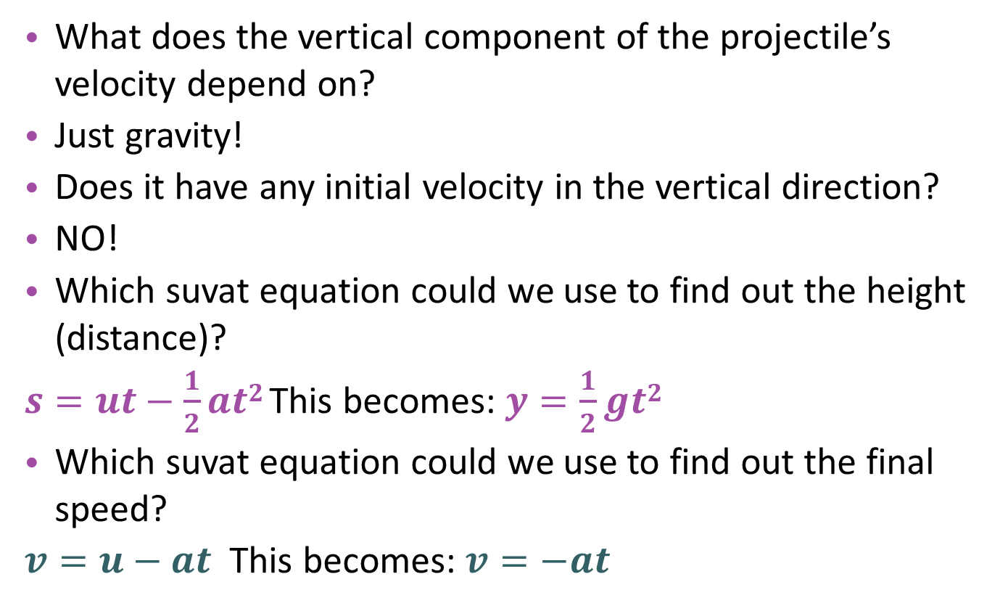
The vertical component
LO:Describe the effect of gravity on horizontal and vertical speed
What does the vertical component of the projectile’s velocity depend on?
Just gravity!
Does it have any initial velocity in the vertical direction?
NO!
Which suvat equation could we use to find out the height (distance)?
$s=ut−\frac{1}{2}at2$This becomes: $y=\frac{1}{2}gt2$
Which suvat equation could we use to find out the final speed?
$v=u−at$This becomes: $v=−at$
Note: There is a ‘-’ rather than a ‘+’ because it is travelling downwards!

Slide 83
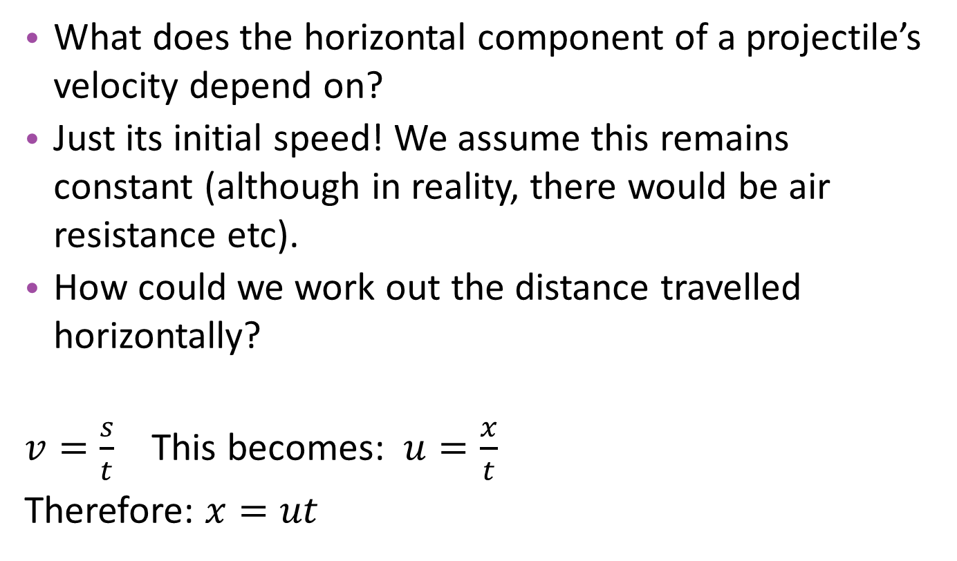
The horizontal component
LO:Describe the effect of gravity on horizontal and vertical speed
What does the horizontal component of a projectile’s velocity depend on?
Just its initial speed! We assume this remains constant (although in reality, there would be air resistance etc).
How could we work out the distance travelled horizontally?
$v=\frac{s}{t}$ This becomes: $u=\frac{x}{t}$
Therefore: $x=ut$
An object that also has horizontal motion, e.g. something being thrown off a cliff! It follows a curved path which obeys these rules:
Its path becomes steeper as it drops
The faster it is projected, the further it will travel
The time taken to drop doesn’t depend on how far it goes

Slide 84
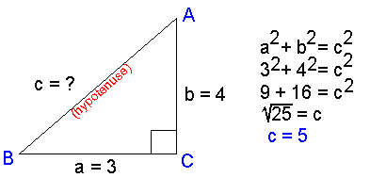
Resultant velocity
LO:Describe the effect of gravity on horizontal and vertical speed
So, if we have a vertical component and a horizontal component, how could we work out the resultant displacement or velocity?
Using Pythagoras!

Slide 85
Practising projectiles
LO:Describe the effect of gravity on horizontal and vertical speed
A lemming runs over the edge of a cliff with a horizontal velocity of 15 ms⁻¹. The cliff is 150 m high. Ignoring air resistance and taking g = 10 ms⁻², calculate:
The time taken for the lemming to reach the ground
The distance it lands from the foot of the cliff
The magnitude of the lemming’s velocity when it hits the ground
Solution
Vertical motion: S = ut + ½ at², take ut to be 0 and rearrange to find t
Horizontal motion: x = Ut
Need to find resultant: horizontal velocity = 15ms⁻¹
vertical velocity = v = u + at = 55 ms⁻¹
Then use Pythagoras to find the resultant velocity: (v_{x}² + v_{y}²) ^{½}

Slide 86
If we switched of gravity…
LO:Describe the effect of gravity on horizontal and vertical speed
An object projected at a certain velocity at angle Ɵ above the horizontal, if we assume velocity would be unchanged, we can work out its displacement as follows…
However, we do have gravity, so what would happen next?
Vertical displacement y = Ut sinƟ
Speed, U (displacement = Ut)
Ɵ
Horizontal displacement x = Ut cosƟ

Slide 87
Practising projectiles
LO:Describe the effect of gravity on horizontal and vertical speed
A golfer hits a ball so that it moves off with a velocity of 26 ms⁻¹ at 30° to the horizontal. Ignoring any air resistance and taking g = 10 ms⁻², calculate:
The time the ball is in the air
The horizontal distance travelled
Solution
Vertical motion:
Vertical velocity, u = 26 x sin30 = 13 ms⁻¹
v = u + at, t = 13 / 10 = 1.3 s (to get from start to highest point), so 2.6 s to get back to ground
Horizontal displacement: ut cosƟ = 26 x 2.6 x cos30 = 59 m

Slide 88
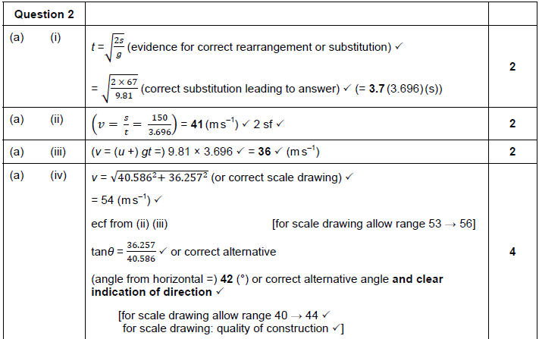
Plenary: Jan ‘11 Q2
LO:Describe the effect of gravity on horizontal and vertical speed

Slide 89
Mechanics and Materials part 1 16 – Force and acceleration
LO: Describe the effect a resultant force produces

Slide 90
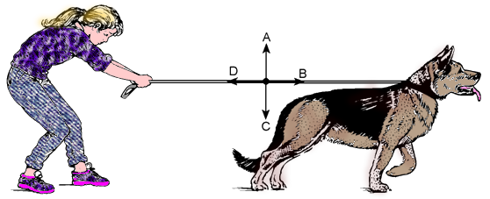
Starter: Force arrows
LO: Describe the effect a resultant force produces
In pairs, match the force arrows up with the pictures.

Slide 91
Some mwb questions…
LO: Describe the effect a resultant force produces
When are forces balanced?
What is friction?
What is movement like in the absence of friction?
Which forces are balanced when a lorry is moving at a constant velocity?
Define F = ma with the units for each

Slide 92
Newton’s Laws of motion
LO: Describe the effect a resultant force produces
Can you tell me any of them?
Newton’s First Law
If there is no resultant force acting on an object:
If it is at rest, it will stay at rest
If it is moving, it keeps moving at a constant velocity
Newton’s Second Law
Force (N) = mass (kg) x acceleration (N/kg or in ms⁻²)
This equation is only used when the mass is constant
(often these questions require you to calculate the acceleration and then the force!)
Newton’s Third Law
To every action force, there is an equal and opposite reaction force

Slide 93
Where does F = ma come from?
LO: Describe the effect a resultant force produces
Look at this table of data… what does the Force depend on?
Force (N) | Mass (kg) | Acceleration (ms⁻²) | Mass x acceleration
1 | 0.1 | 10 | 1
2 | 0.2 | 10 | 2
3 | 0.1 | 30 | 3
4 | 0.2 | 20 | 2
It shows that F is proportional to ma.
A Newton is a unit of force that will give an object of mass 1 kg an acceleration of 1 ms⁻².
Therefore: F = ma. This is Newton’s second law.

Slide 94
A bit of practise
LO: Describe the effect a resultant force produces
A rocket of mass 1000 kg carries 800 kg of fuel at take-off. If the thrust T from the engines is 22 000 N, calculate its initial acceleration.
(Hint: you will need to work out its resultant upward force)
Step by Step Solution:
Total initial mass = 1000 + 800 = 1800 kg
Resultant upward force = Thrust – weight = 22 000 – (1800 x 10) = 4000 N
a = F / m = 4000 / 1800 = 2.2 ms⁻²

Slide 95
Weight vs mass
LO: Describe the effect a resultant force produces
What is the difference between mass and weight?
Working out weight is just another version of Newton’s 2nd Law:
F = ma → F = mg → W = mg
When an object is in equilibrium, the support force is equal and opposite to its weight
g = the gravitational field strength. On Earth, g = 9.81 N/kg, on the moon, g = 1.62 N/kg
Inertia = an object’s resistance to change of motion. The mass of an object is a measure of its inertia.

Slide 96
Practise questions
LO: Describe the effect a resultant force produces
A train of mass 740 tonnes accelerates at 0.05 ms⁻². Calculate the resultant force on the train.
A shopper pushes a trolley of mass 28 kg with a horizontal force of 12 N. What is the acceleration?
An aircraft of mass 1.6 x 10⁴ kg tows a glider of 0.6 x 10⁴ kg. When the thrust of the aircraft is 8.3 x 10⁴ N the glider accelerates. What is the acceleration AND the tension in the cable?

Slide 97
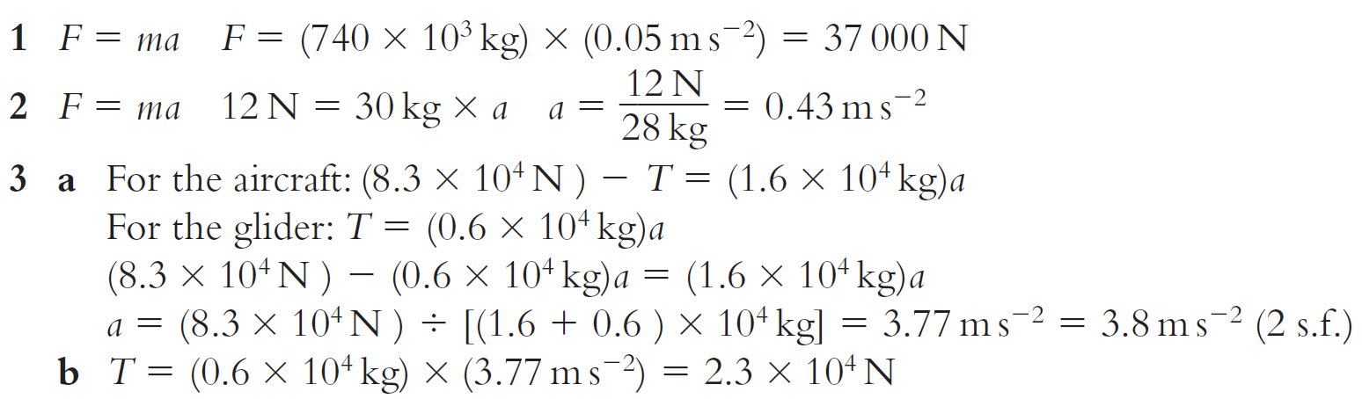
Answers
LO: Describe the effect a resultant force produces

Slide 98
Plenary: Jun ’13 Q2+3
LO: Describe the effect a resultant force produces

Slide 99
Mechanics and Materials part 1 17 – Using F = ma
LO: Apply the equation to different situations and describe situations in which it can not be used.

Slide 100
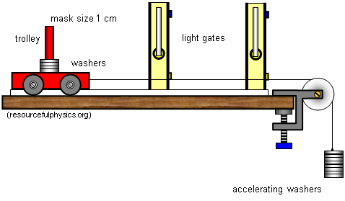
Starter: Effects on acceleration
LO: Apply the equation to different situations and describe situations in which it can not be used.
We are going to complete this practical as a class. Read the instructions, stick them in your log book and draw the results table.

Slide 101
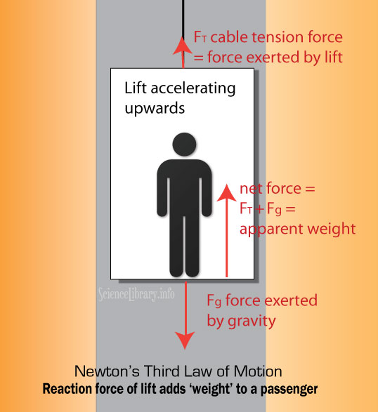
Rockets and lifts
LO: Apply the equation to different situations and describe situations in which it can not be used.
F = ma → F = T – mg → T – mg = ma
T = mg + ma
Question:
A passenger travels in a lift that is accelerating upwards at a rate of 1.5 ms⁻². The passenger has a mass of 62 kg and the lift has a mass of 250 kg. Calculate the tension in the lift cable.
Answer:
T = ((62 + 250) x 9.81) + ((62 + 250) x 1.5)
T = 3060 + 468 = 3500 N (2 s.f.)

Slide 102
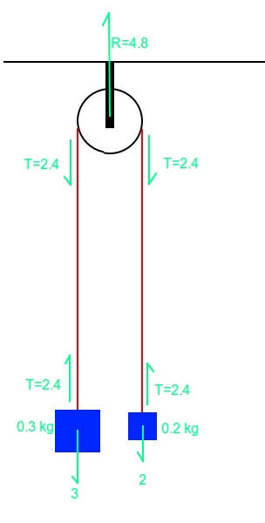
Pulleys
LO: Apply the equation to different situations and describe situations in which it can not be used.
If two masses, one small (m) and one large (M) hang on either side of a pulley on a thread of tension T, mass m will accelerate upwards and mass M will accelerate downwards:
Mass M → Mg – T = Ma
Mass m → T – mg = ma
Adding them together → Mg – mg = (M + m)a

Slide 103
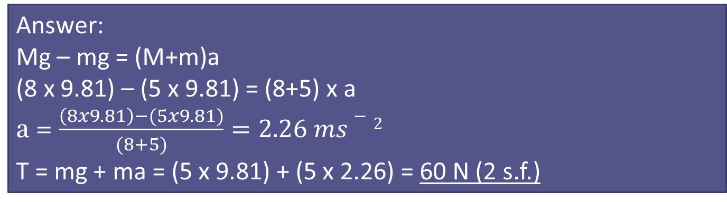
Pulleys
LO: Apply the equation to different situations and describe situations in which it can not be used.
Mass M → Mg – T = Ma
Mass m → T – mg = ma
Adding them together → Mg – mg = (M + m)a
Question:
Two masses, one of 5 kg and one of 8 kg are connected by a string that does not stretch and passes over a frictionless pulley as shown. Calculate the tension in the string and the acceleration of the masses.
Answer:
Mg – mg = (M+m)a
(8 x 9.81) – (5 x 9.81) = (8+5) x a
a = $\frac{\left(8x9.81\right)−(5x9.81)}{(8+5)}=2.26 ms−2$
T = mg + ma = (5 x 9.81) + (5 x 2.26) = 60 N (2 s.f.)

Slide 104
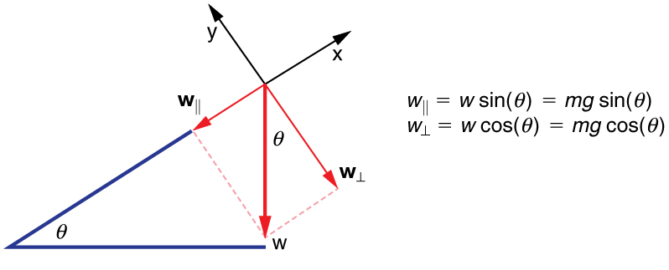
Sliding down slopes
LO: Apply the equation to different situations and describe situations in which it can not be used.
Component weight down a slope = mgsinƟ
Taking friction into account → mgsinƟ – F₀
Therefore mgsinƟ – F₀ = ma
Attempt summary question 4.

Slide 105
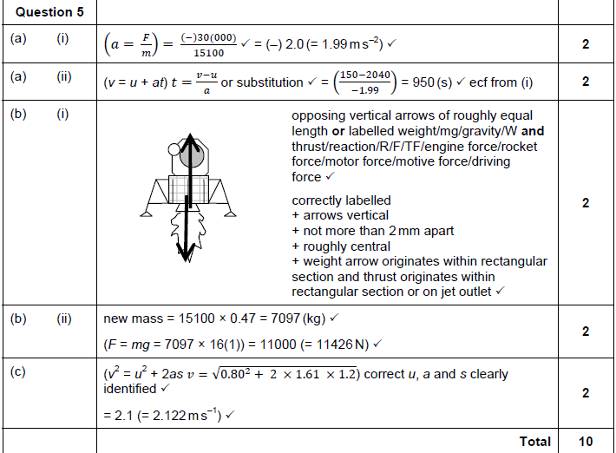
Plenary: Jan ‘11 Q5
LO: Apply the equation to different situations and describe situations in which it can not be used.

Slide 106
Mechanics and Materials part 1 18 – Terminal Speed
LO: Explain what determines the terminal speed of an object.

Slide 107

Starter: Paper aeroplanes
LO: Explain what determines the terminal speed of an object.
Using the templates I have given you, make a paper aeroplane.
What determines how far it travels?
What determines its final speed?
The drag it experiences… but what affects the drag?
The shape of object, the speed, the viscosity of the fluid (whether it is gas or liquid).
Remember, the faster it travels, the greater the drag force!

Slide 108
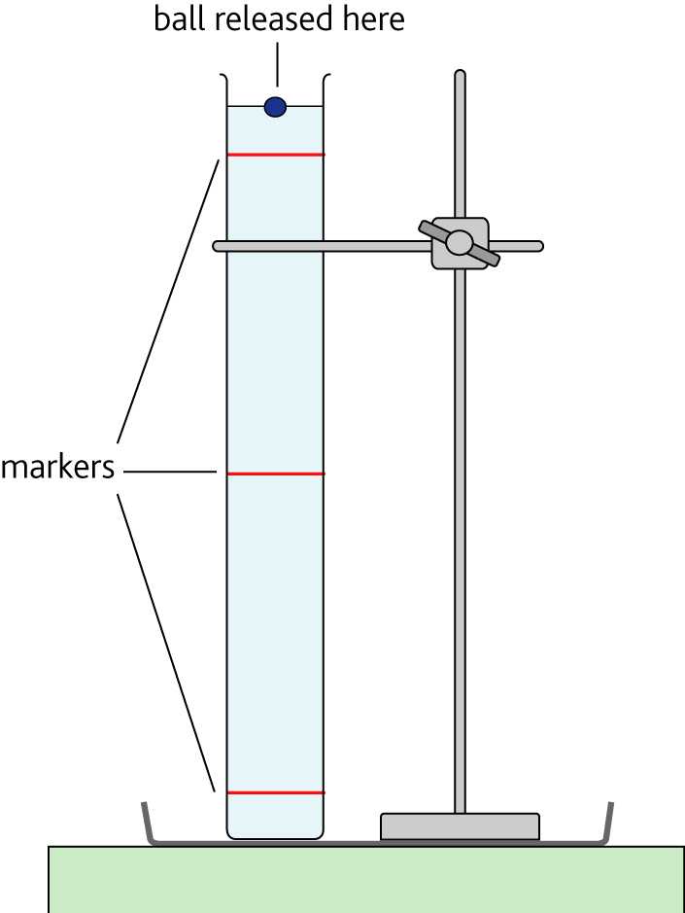
Investigating terminal speed
LO: Explain what determines the terminal speed of an object.
Follow the instructions on your method sheet carefully.
Remember to write in pencil and date and title your work.
Decide what measurements to take and record in a table.
Complete remaining questions.

Slide 109
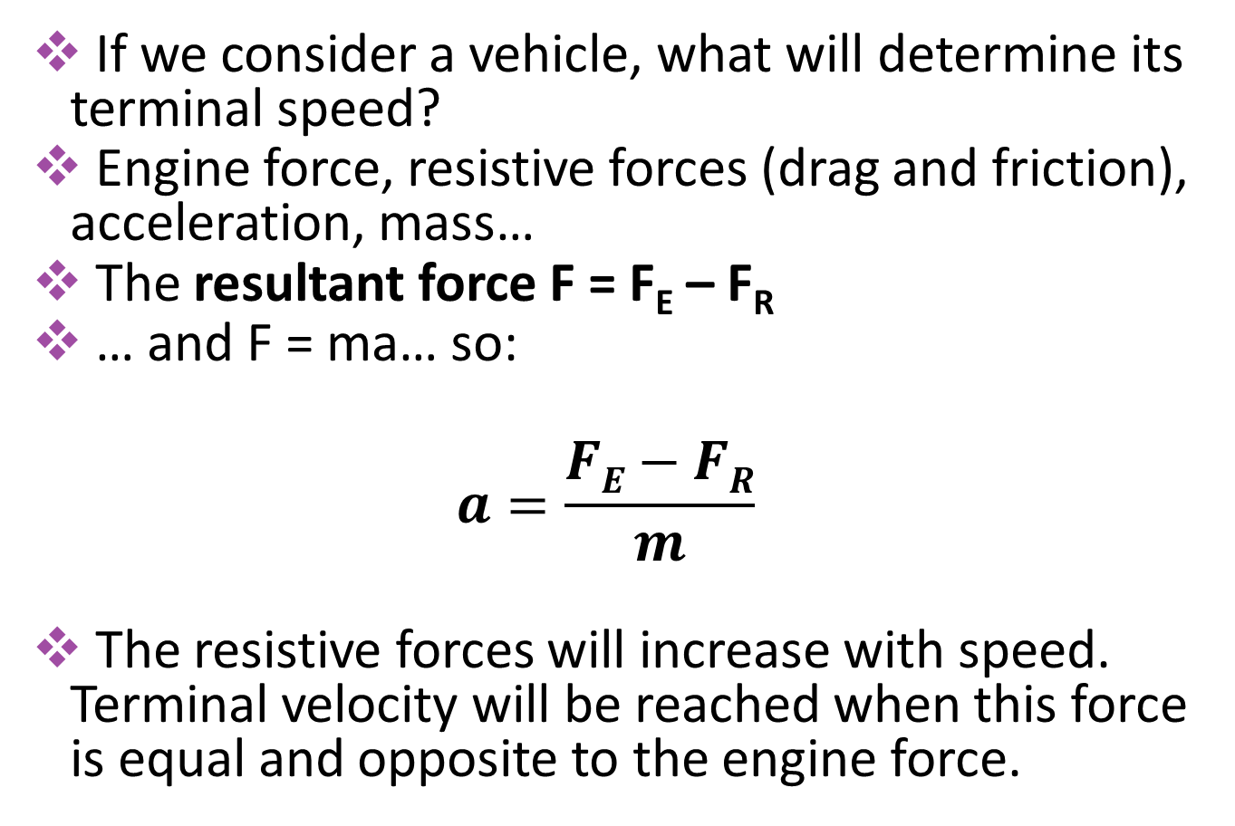
What about horizontally?
LO: Explain what determines the terminal speed of an object.
If we consider a vehicle, what will determine its terminal speed?
Engine force, resistive forces (drag and friction), acceleration, mass…
The resultant force F = F_{E} – F_{R}
… and F = ma… so:
$$a=\frac{FE−FR}{m}$$
The resistive forces will increase with speed. Terminal velocity will be reached when this force is equal and opposite to the engine force.

Slide 110
Some practise…
LO: Explain what determines the terminal speed of an object.
A skydiver has a mass, with his parachute, of 77 kg. What is the air resistance when he reaches terminal velocity?
Felix Baumgartner set a record in October 2012 for a speed in free-fall of 370 ms⁻¹ and falling from a height of 39 045 m. Why did he not reach a lower terminal velocity?
Use graph paper to sketch a graph of terminal velocity against time for the following skydive: V_{T1} = 50 ms⁻¹ reached at t = 27 s, and V_{T2} = 10 ms-1, reached at t = 46 s.
A skydiver, with her parachute, has a mass of 68 kg. She is falling with a velocity of 48 ms⁻¹ when she opens her parachute. The air resistance increases to 720 N. Calculate her acceleration.

Slide 111
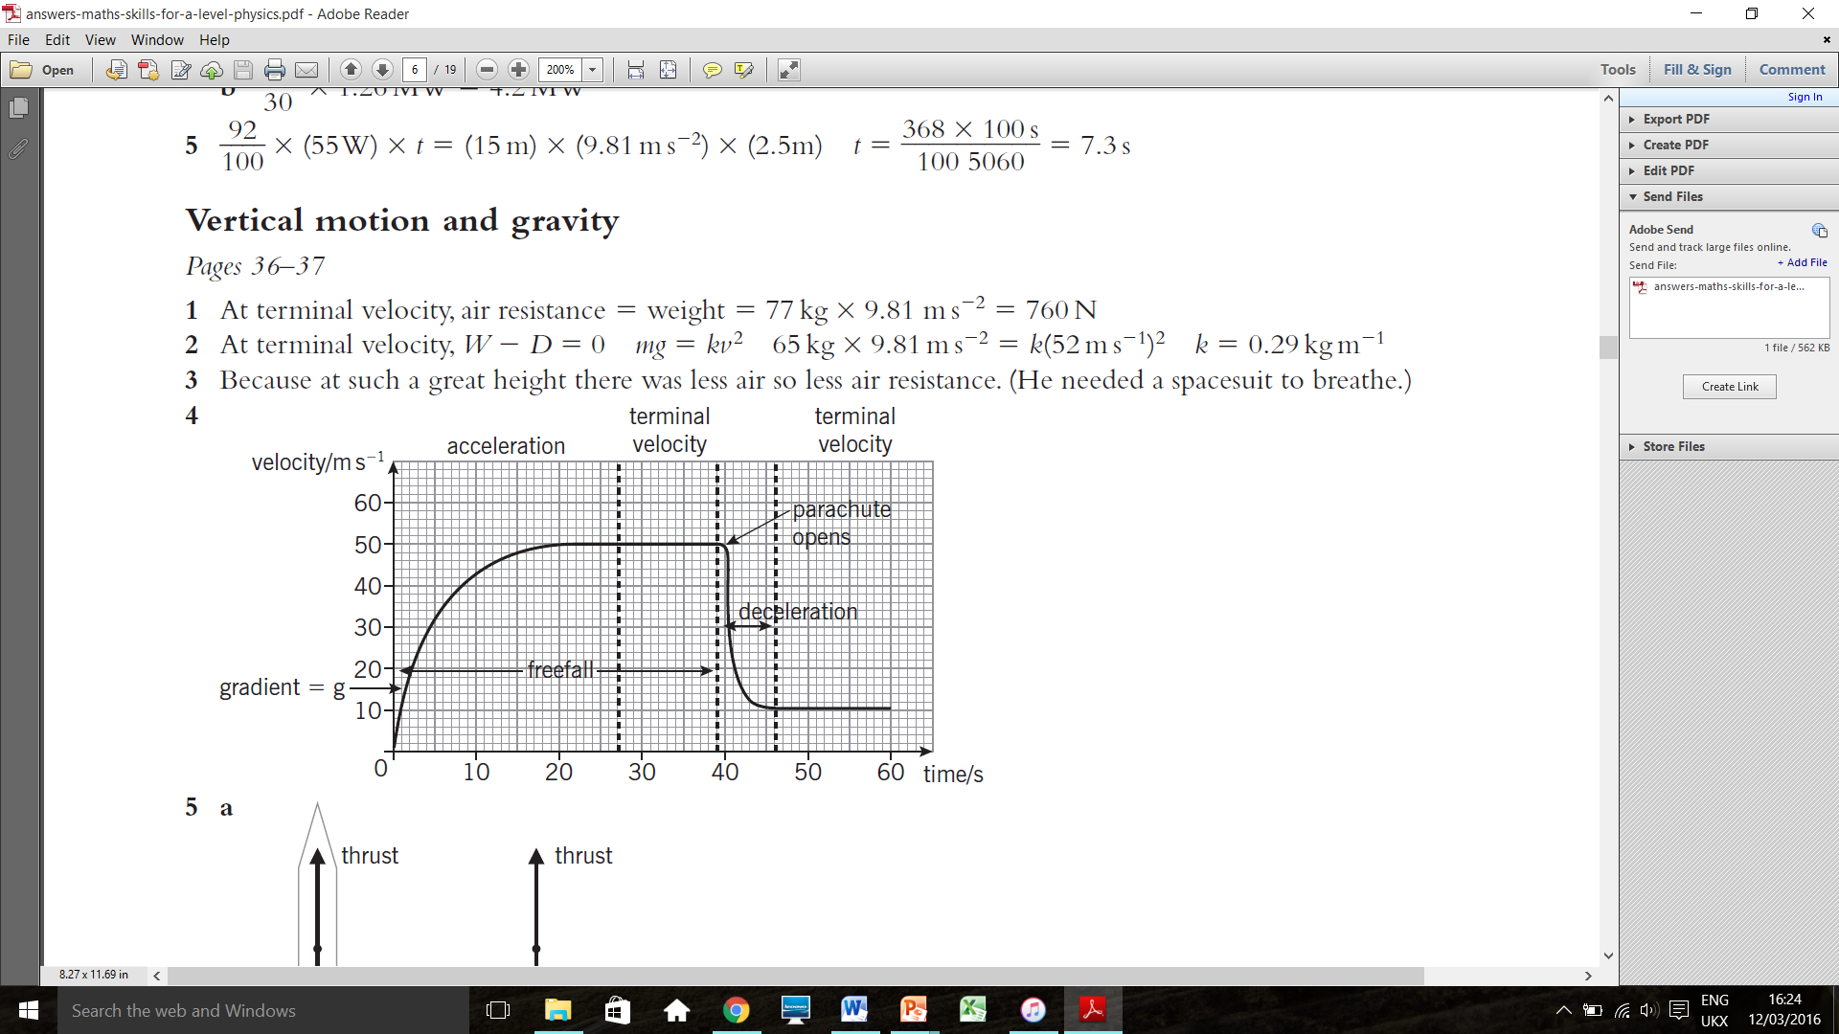
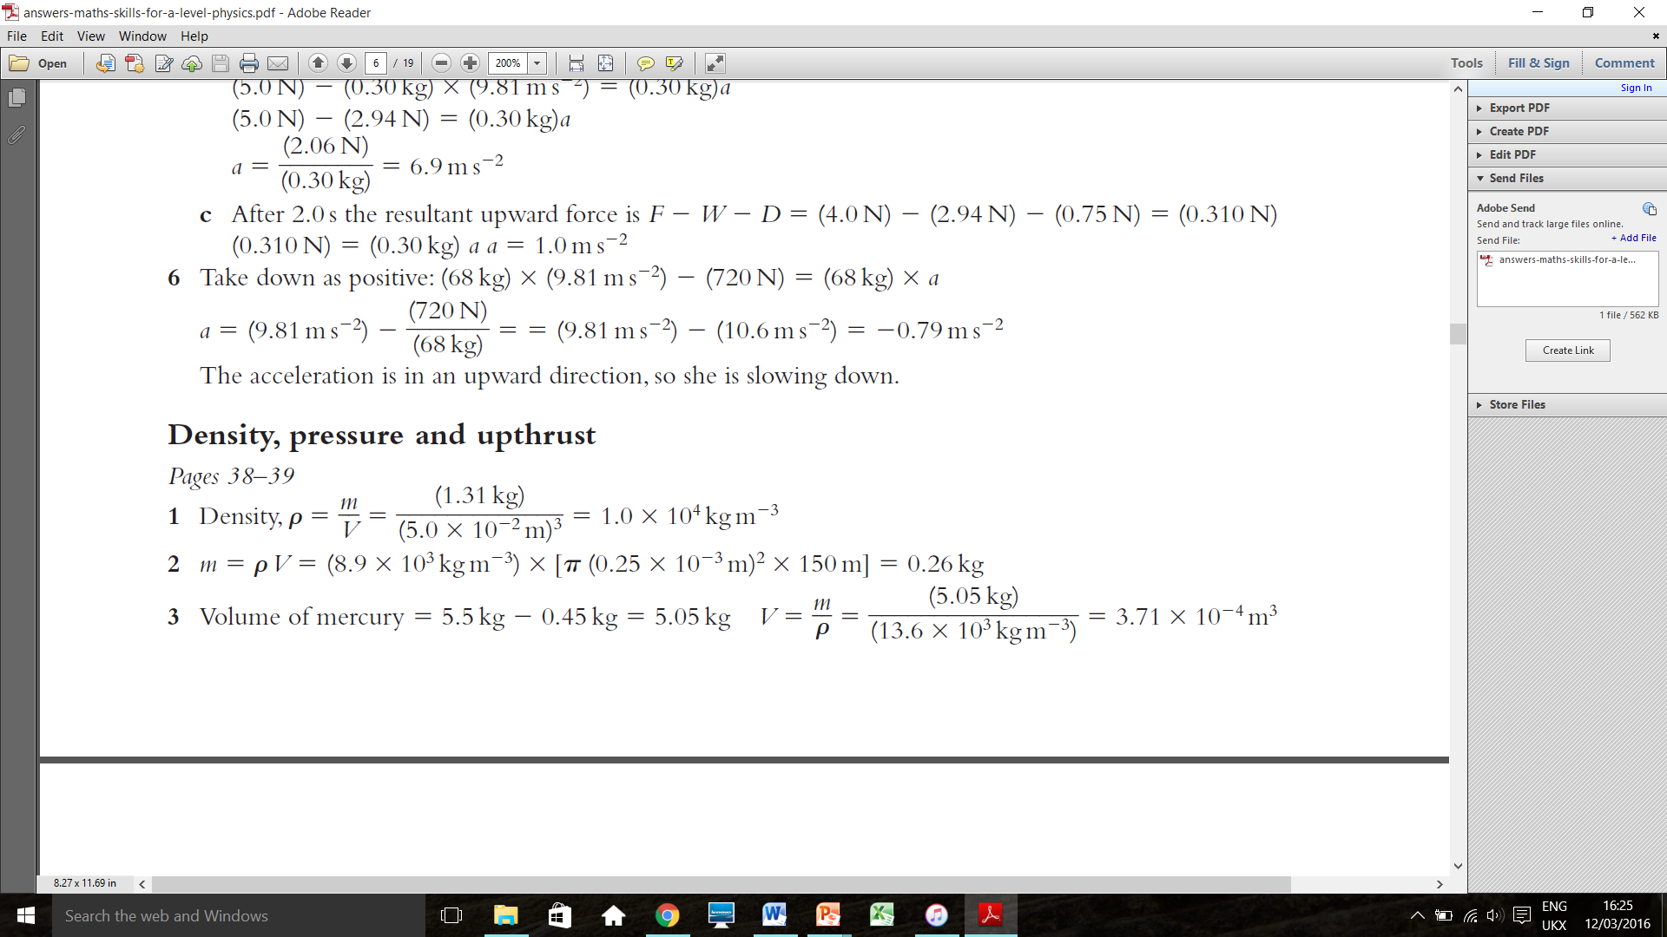
Some answers
LO: Explain what determines the terminal speed of an object.

Slide 112
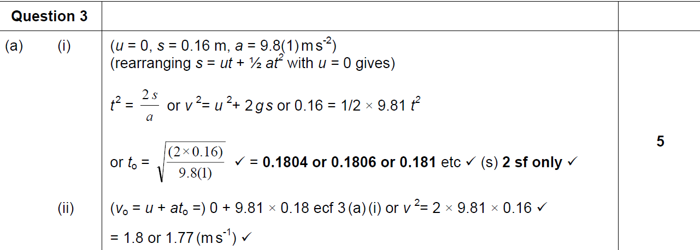
Plenary: Jun ‘09 Q3
LO: Explain what determines the terminal speed of an object.

Slide 113
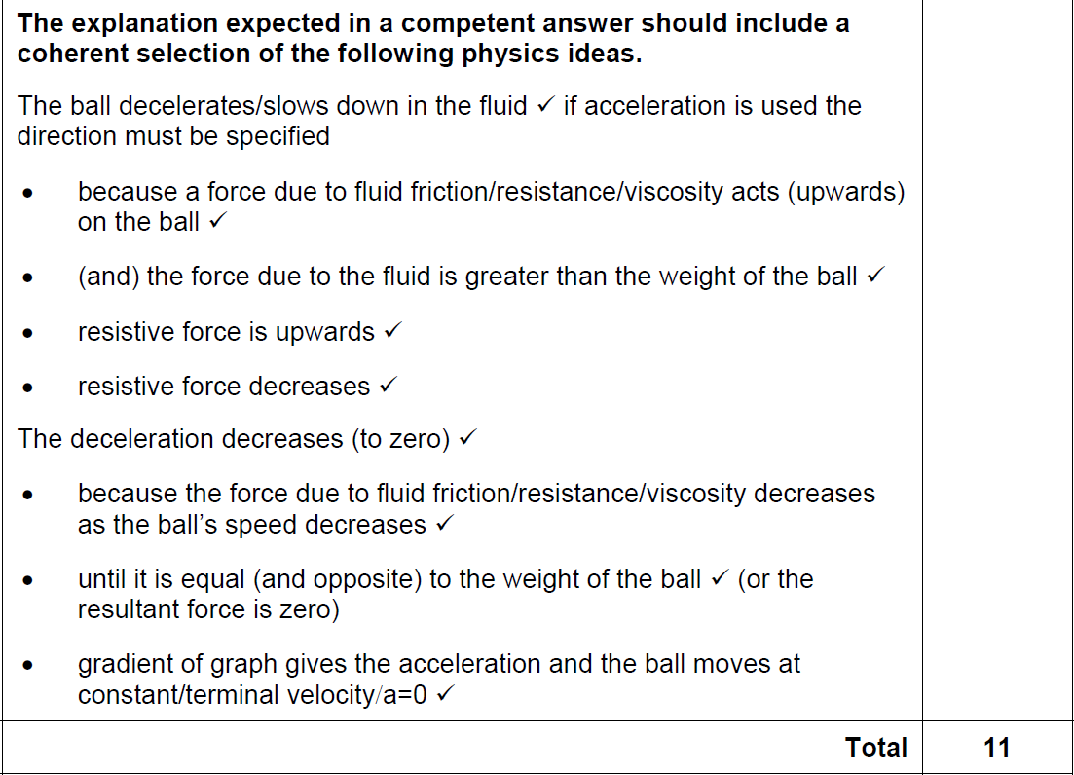
LO: Explain what determines the terminal speed of an object.

Slide 114
Mechanics and Materials part 1 19 – Momentum and Impulse
LO: Connect Newton’s 1st and 2nd Laws with momentum.

Slide 115
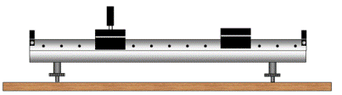
Air track
LO: Connect Newton’s 1st and 2nd Laws with momentum.
What would affect the impact between these two vehicles?
What might happen if one was much more massive than the other?
The speed something was travelling and how massive it was would affect the impact. The faster and more massive it is, the bigger the momentum:
p = mv
What units would you give momentum?

Slide 116
Newton and Momentum
LO: Connect Newton’s 1st and 2nd Laws with momentum.
Newton’s first law of motion: an object remains at rest or in uniform motion unless acted on by a force
This tells us:
A force is needed to change an object’s momentum
If a moving object gains or loses mass, the velocity will change to preserve momentum
Newton’s second law of motion: the rate of change of momentum of an object is proportional to the resultant force acting on it. The change in momentum will be in the same direction as that force.

Slide 117
Why does F = ma?
LO: Connect Newton’s 1st and 2nd Laws with momentum.
Force, F
Force, F
Initial speed, u
Speed at time t, v
The car has a constant force and a constant mass
It accelerates, causing a change from initial speed (u) to speed (v) in time t.
Momentum, p = mass, m x velocity, v
The car’s initial momentum = mu, its final momentum = mv
The change in momentum, Δp = final momentum, mv – initial momentum, mu
According to Newton’s 2nd law: “the rate of change of momentum of an object is proportional to the resultant force acting on it”
Therefore, force, F = change of momentum / time taken
F = (mv – mu) / t
F = m (v – u) / t = ma (acceleration = change in velocity over time)
This equation can always be used, F = ma can only be used when mass is constant!

Slide 118
MWB Questions
LO: Connect Newton’s 1st and 2nd Laws with momentum.
Calculate the momentum of an elephant of mass 7000 kg moving at 4 ms⁻¹
p = mv = 7000 x 4 = 28 000 kg m s⁻¹
A rocket has a mass of 1500 kg when it begins travelling at a constant velocity of 20 ms⁻¹. It then loses fuel at a rate of 0.5 kg every 30 seconds. What will the difference in force from the engine be after 10 minutes?
F = vΔm / Δt
Δm = 10 kg, Δt = 600 s
F = 20 x 10 / 600 = 0.33 N

Slide 119
Impulse
LO: Connect Newton’s 1st and 2nd Laws with momentum.
In sports like tennis, golf… etc. what’s the point in ‘following through’?
By following through, the force acts for a longer time. This is useful because:
Newton’s first law: resultant force = change in momentum
time taken
Rearranging gives us: Force x time = change in momentum
This tells us the greater the force and the greater the time it acts for, the greater the change of momentum
The impulse of a force = force x time the force acts for.
Impulse is measure in N s, and 1 Ns = 1 kg ms-1

Slide 120
Impulse questions
LO: Connect Newton’s 1st and 2nd Laws with momentum.
What is the impulse produced by a force of 4 N acting for 3 s?
Impulse = F x t = 4 x 3 = 12 Ns
What effect will this impulse have on the velocity of a 2 kg mass?
An impulse of 12 Ns will produce a change in momentum of 12 kg ms⁻¹
p = mv, 12 = 2 x v, v = 6 ms⁻¹
What effect will this impulse have on the velocity of a 3 kg mass?
p = mv, 12 = 3 x v, v = 4 ms⁻¹

Slide 121
Force-time graphs
LO: Connect Newton’s 1st and 2nd Laws with momentum.
If we draw a graph of force against time, how would you work out the area under the graph?
What would the area under the graph show?
Sketch a graph of the force applied to a golf ball by a golf club over time. The force steadily increases from 0 N at time 0 s to 150 N at time 0.1 s, it then steadily decreases to 0 N at 0.2 s. How would you work out the impulse between 0.05 and 0.06 s from your graph?

Slide 122
Plenary: Questions
LO: Connect Newton’s 1st and 2nd Laws with momentum.
A jet engine travels forwards at a velocity of 195 ms⁻¹ by emitting 75 kg of exhaust gases per second. What is the forward force on the jet engine?
A truck of mass 2 tonnes travels at a speed of 30 ms⁻¹, calculate its momentum.
Water from a hose flows at 2.0 kgs⁻¹ and strikes a wall horizontally at a velocity of 3.0 ms⁻¹. Calculate the force on the wall assuming the water stops moving horizontally after hitting the wall.
Now complete the questions on pg 155 of CGP textbook.

Slide 123
Mechanics and Materials part 1 20 – Impact Forces
LO: Describe what happens to the momentum of a ball when it bounces off a wall.

Slide 124

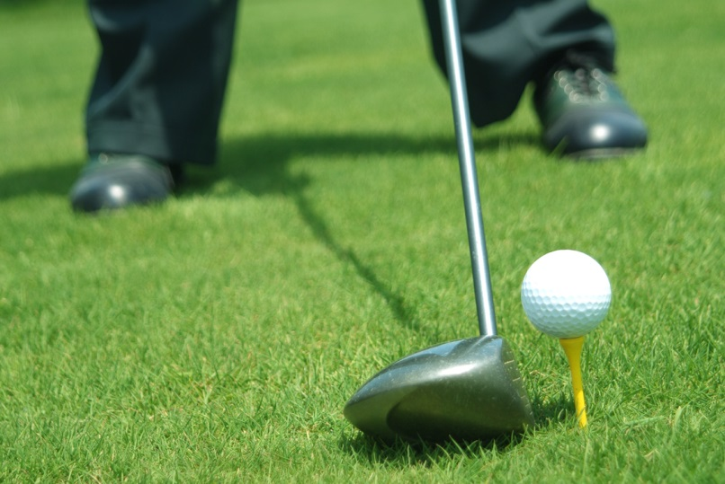
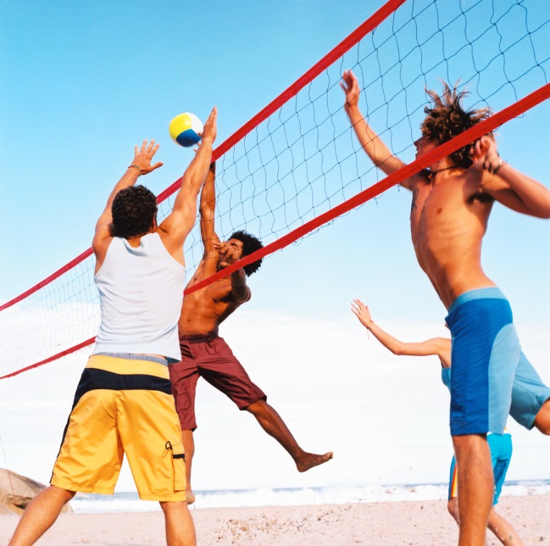


What do all of these sports have in common?
LO: Describe what happens to the momentum of a ball when it bounces off a wall..
What determines how far the ball travels in each case?

Slide 125
Impacts
LO: Describe what happens to the momentum of a ball when it bounces off a wall..
(Oxford book handout pg 158-159)
Impact changes the momentum of the ball etc. very quickly
If it is stationary:
force of impact = change in momentum
contact time
F = ∆p / t = mv / t
If it is already moving:
F = ∆p / t
F = (mv – mu) / t
There is a change in momentum due to acceleration
There is a change in momentum due to change from initial velocity u to final velocity v

Slide 126
Impact question
LO: Describe what happens to the momentum of a ball when it bounces off a wall..
A boy catches a cricket ball of mass 0.14 kg, which has a velocity of 20 m/s. Calculate:
The momentum of the ball,
The average force used by the boy’s hands to stop the ball in 0.5 s
and in 0.01 s,
Can you explain why stopping the ball in 0.01 s hurts the boy, but stopping it in 0.5 s does not?
Answer:
Momentum = mv = 0.14 x 20 = 2.8 kg m/s
When brought to rest, the ball’s momentum drops to zero, therefore change in momentum = -2.8 kg m/s. F = ∆ (mv) / ∆t = -2.8 / 0.5 = -5.6 N
-2.8 / 0.01 = - 280 N
The ball applies an equal and opposite force to his hands. In 0.01 s, it applies a force of 280 N to his hands. When he stops it slowly, the force is less, therefore it hurts less.

Slide 127

Graphs for Impacts
LO: Describe what happens to the momentum of a ball when it bounces off a wall..
F = ∆p / t = mv / t
How would you draw a graph for an impact? Sketch it on your whiteboard.
What would be on the axes?
What would the shape of the graph be? Why?
This is a force-time graph for an impact
What do you think the area under the graph would allow you to calculate? How would you do this?
Remember! Reaction forces – the force on the bat due to the ball is the same as the force on the ball due to the bat!

Slide 128
Rebound Impacts
LO: Describe what happens to the momentum of a ball when it bounces off a wall..
(DEMO)
Describe the momentum and the velocity of the ball and how it changes.
When a ball rebounds normally (hits the wall perpendicularly and goes back the same way), the initial velocity u is positive (+) and the final velocity v is negative (-)
Therefore:
Change in momentum = (-mv) – (mu)
Force due to impact F = (-mv) – (mu) / t
If there is no loss of speed, then: v = -u
Therefore:change in momentum = (-mu) – (mu) = -2mu
Therefore the impact force, F = -2mu / t
+ u
- v

Slide 129
Oblique Impacts
LO: Describe what happens to the momentum of a ball when it bounces off a wall..
If the impact was oblique like the example (right), how would it change from what we have discussed?
Evaluate how you would tackle this problem. Where would you start?
Hint: think vectors!
You have to use the normal components of the initial and final speeds!
If there is no loss of speed (v = u), and the initial and final angle are the same…
…Using trigonometry what will the normal components be?
+uCos θ and –uCos θ
Therefore change in momentum = (-muCos θ) – (muCos θ) = -2muCosθ
+ u
v
(or –u)

Slide 130
Summary Question 4
LO: Describe what happens to the momentum of a ball when it bounces off a wall..
Molecule mass = 5.0 x 10-²⁶ kg
Speed = 420 m/s
Time for impact = 0.22 ns = 0.22 x 10⁻⁹ s
Change in momentum = -2muCosθ
= -2 x (5.0 x 10-²⁶) x 420 x Cos60
= 2.1 x 10⁻²³ kg m/s
Force of impact = change in momentum / time taken
= 2.1 x 10⁻²³ / 0.22 x 10⁻⁹
= 9.54 x 10⁻¹⁴ N

Slide 131


Plenary: Jan ‘11 Q2
LO: Describe what happens to the momentum of a ball when it bounces off a wall..
You will need to link conservation of momentum and conservation of energy
You will also need to remember that:
Ek = ½ mv²

Slide 132
Mechanics and Materials part 1 21 – Conservation of momentum
LO: Define conservation of momentum and state the conditions which must be satisfied

Slide 133
Starter: Newton’s cradle
LO: Define conservation of momentum and state the conditions which must be satisfied.
How does it work?
The momentum gets transferred from one ball to the other. The momentum is conserved.
If there were no external forces acting, they would carry on forever – the momentum within the system would be conserved.
The principle of conservation of momentum states that for a system of interacting objects, the total momentum remains constant, providing no external force acts on the system.

Slide 134
Newton’s laws
LO: Define conservation of momentum and state the conditions which must be satisfied.
Law 1) An object remains at rest or in uniform motion unless acted on by a force
Remind me of them…
We will be focussing on the third law today.
Law 2) The rate of change of momentum of an object is proportional to the resultant force acting on it
Law 3) When two objects interact, they exert equal and opposite forces on each other…

Slide 135
Conserving momentum
LO: Define conservation of momentum and state the conditions which must be satisfied.
If two or more objects collide, they exert equal and opposite forces on each other
If an external force interacts, then their momentum changes
If there are no external forces, the momentum can be transferred between the objects, but the overall momentum will not change
If these two balls collide and separate, their momentum is transferred
They exert equal and opposite forces on each other, therefore their changes in momentum are equal and opposite
Impact force F1 on ball A due to ball B:
F1 = (m_{A}v_{A} – m_{A}u_{A}) / t
Impact force F2 on ball B due to ball A:
F2 = (m_{B}v_{B} – m_{B}u_{B}) / t
These two forces are equal and opposite, i.e. F1 = -F2 .
Therefore (m_{A}v_{A} – m_{A}u_{A}) / t = -(m_{B}v_{B} – m_{B}u_{B}) / t
(m_{A}v_{A} – m_{A}u_{A}) = -(m_{B}v_{B} – m_{B}u_{B}) (when we multiply out, we multiply by -1)
→m_{A}v_{A} – m_{A}u_{A} = -m_{B}v_{B} + m_{B}u_{B}
m_{B}v_{B} + m_{A}v_{A} = m_{A}u_{A} + m_{B}u_{B}
Therefore, total final momentum = total initial momentum. Momentum is conserved! ☺
u_{A}
u_{B}
v_{A}
v_{B}

Slide 136
Colliding questions
LO: Define conservation of momentum and state the conditions which must be satisfied.
A car of mass 1000 kg moving at 20 ms-1 collides with a car of 2300 kg moving at 5.0 ms-1 in the same direction. If the second car is shunted forwards at 15 ms-1 by the impact, what is the velocity v, of the first car immediately after the crash?
If the same cars collide head-on at the same speeds, what would their combined velocity v, be after the collision if they stick together on impact?
A bullet of mass 10 g is fired at 400 ms-1 from a rifle of mass 4.0 kg. What is the recoil velocity v, of the rifle?
The same bullet is fired into a block of wood of mass 390 g resting on a smooth surface. If the bullet remains embedded in the wood, calculate the velocity v, that the block moves off at.

Slide 137
Colliding answers
LO: Define conservation of momentum and state the conditions which must be satisfied.
1. Momentum before collision = momentum after collision
(1000 x 20) + (2300 x 5) = (1000 x v) + (2300 x 15)
2. Momentum before = momentum after
(1000 x 20) – (2300 x 5) = (1000 + 2300) x v
3. Momentum before = momentum after
0 = (0.010 x 400) + (4.0 x v)
v = -1.0 (to the left as answer is -)
4. Momentum before = momentum after
(0.010 x 400) + 0 = (0.010 + 0.390) x v
4.0 = 0.400 x v
v = 10 ms-1 (to the right)

Slide 138
Investigation: Testing conservation of momentum
LO: Define conservation of momentum and state the conditions which must be satisfied.
Aim: take measurements and test that momentum is conserved in the collision
Safety: make sure trolley doesn’t fall of bench, use a rubber matt to protect the bench
Method: follow the instructions on the practical sheet
Results: carry out the calculations detailed – we will discuss these afterwards:
Calculate the momentum of trolley A before the collision ( = mA vA ) and the total momentum of the trolleys A and B after the collision ( = (mA + mB)V )
Calculate the ratio R = the total momentum after the collision the total momentum before the collision
Estimate the uncertainty in the total momentum before the collision and the total momentum after the collision.
Was momentum conserved?

Slide 139

Plenary: TAP Inelastic collisions
LO: Define conservation of momentum and state the conditions which must be satisfied.

Slide 140
Mechanics and Materials part 1 22 – Elastic and Inelastic Collisions
LO: Explain the differences between elastic and inelastic collisions.

Slide 141

Starter: Bounce
LO: Explain the differences between elastic and inelastic collisions.
Make a list of objects which bounce well and objects that don’t bounce well
Give a suitable name to each list and explain why you have given it this name
Describe the kinetic energy involved when objects in each list bounce or not
A suitable name would be elastic and inelastic – things that are elastic bounce, things that aren’t do not.

Slide 142
Elastic and Inelastic collisions
LO: Explain the differences between elastic and inelastic collisions.
We know that, if there is no external force, momentum is conserved
Energy can be different – the total energy is conserved, but the kinetic energy might not be:
An elastic collision is one where there is no loss of kinetic energy
i.e. total kinetic energy before collision = total kinetic energy after collision
An inelastic collision is where the colliding objects move apart, and have less kinetic energy after the collision than before
i.e. total kinetic energy before collision > total kinetic energy after collision
What would be different about the height this ball reached when it bounced if the collision was elastic or inelastic?

Slide 143
Using a ratio of heights…
LO: Explain the differences between elastic and inelastic collisions.
When things are falling and bouncing, we can work out how much kinetic energy is recovered using a ratio of heights reached
If a ball with mass m falls from a height H above the floor and rebounds to height h:
Loss of potential energy (mgH) = kinetic energy immediately before impact
Gain of potential energy through height h (mgh) = kinetic energy immediately after impact
The ration h/H tells you how much kinetic energy is recovered after the collision. If it doesn’t bounce at all, h will be zero and the collision is completely inelastic. If the object gets to the same height, the ratio will be 1, so the kinetic energy is completely conserved and the collision is elastic!

Slide 144
Example question
LO: Explain the differences between elastic and inelastic collisions.
For questions on elastic and inelastic collisions, you need to use the principle of conservation of momentum as well as conservation of energy…
Remember: KE = ½ mv²
A gas molecule of mas 2.0 x 10⁻²⁶ kg moving at 600 ms⁻¹ collides with a stationary molecule of mass 10 x 10⁻²⁶ kg. The first molecule rebounds at 400ms⁻¹. Is this collision elastic or inelastic?
Answer
Total momentum before = total momentum after collision
(2.0 x 10⁻²⁶ x 600) = (2.0 x 10⁻²⁶ x -400) + (10 x 10⁻²⁶ x v)
1200 = -800 + (10 x v)
… v = 2000 / 10 = 200 ms⁻¹
Total KE before collision = ½ x 2.0 x 10⁻²⁶ x 600² = 3.6 x 10⁻²¹ J
Total KE after collision = (½ x 2.0 x 10⁻²⁶ x 400²) + (½ x 10 x 10⁻²⁶ x 200²) = 3.6 x 10⁻²¹ J
As the total energy before and after the collision is the same, the collision is elastic!

Slide 145


More practice
LO: Explain the differences between elastic and inelastic collisions.
Maths skills for A level physics pg 56-57

Slide 146

LO: Explain the differences between elastic and inelastic collisions.

Slide 147


Plenary: Jun ‘10 Q3
LO: Explain the differences between elastic and inelastic collisions.

Slide 148
Mechanics and Materials part 1 23: Explosions
LO: Describe the energy and momentum changes in an explosions.

Slide 149


What happens to momentum in explosions?
LO: Describe the energy and momentum changes in an explosions.
When objects fly apart after being at rest, they move in opposite directions with the same amount of momentum
E.g. with the trolleys:
Total initial momentum = 0
Total momentum straight after explosion: mAvA + mBvB

Slide 150
Explosions and trolleys
LO: Describe the energy and momentum changes in an explosions.
Total initial momentum = 0
Total momentum straight after explosion: m_{A}v_{A} + m_{B}v_{B}
Due to the principle of conservation of momentum:
m_{A}v_{A} + m_{B}v_{B} = 0
Therefore m_{B}v_{B} = -m_{A}v_{A}
(the minus tells us they move in opposite directions)
Now complete the all of the ‘Explosions’ questions I have given you ☺

Slide 151
Answers and Plenary
LO: Describe the energy and momentum changes in an explosions.
0.375 kg
15 ms⁻¹
3 ms⁻¹
3.40 x 10⁵ ms⁻¹
0.417 ms⁻¹
0.284 kg
4 x 10 ⁶ N Increases as mass decreases
a) 1.5 ms⁻¹ b) 2.25 + 1.5 = 3.75 J
807 kms⁻¹
a) 3 x less mass means 3 x more v so 60 ms⁻¹ b) KE_{total} = (0.5 x 3M_{B} x 20²) + (0.5M_{B} x 60²)
= 600M_{B} + 1800M_{B}
So A has (600/(600+1800)) x 100 = 25%
Estimate average mass of person m = 50 kg (NB Population will contain many children)
Jump height _h = 0.2 m Take-off speed ghv2= so 2.0102xxv= = 2 m s-1 (accept any reasonable method or blind guess of about 1 to 3 m s-1)
Total upward momentum of all jumpers:
p =1.3 x 109 x 50 kg x 2 m s-1 = 1.3 x 1011 kg m s-1
To conserve momentum, Earth must acquire equal momentum in the opposite direction.
Earth, mass M, acquires speed v = p/M = 1 x 3 x 1011 / 6 x 1024 = ≈ 2 x 10-14 m s-1 i.e. velocity of the Earth is negligible. An elastic or inelastic jump?
If you finish all of the questions, read through and highlight / underline / make notes on the chapter summary I have given you.
Your test will be on:
Monday 25th April for 12PHA
Friday 29th April for 12PHD

